Slide 1
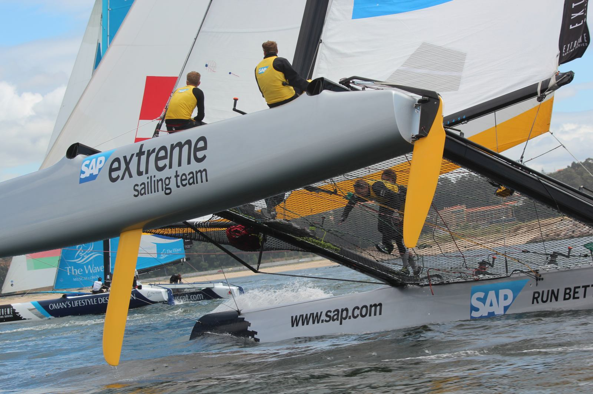

SAP Sailing Analytics
Introduction to System Operations
Axel Uhl, Global Sponsorships
January, 2016

Slide 2
Agenda
  Introduction to SAP Sailing Analytics
    Overview Functions, Features, and Architecture
  First Steps in the Administration Console
    Enabling Users
    Creating an Event
    Adding a Simple Regatta with a Leaderboard
    Adding Competitors
    Entering Scores
  Using the Race Manager App
    Binding a Device
    Logging On
    Planning and Running a Race
    Regularly Updating Wind Data

Slide 3
Agenda
  Advanced Event and Regatta Settings
    Uploading Images and Videos
    Using the Media Gallery
    Setting Event Images for Stage, Logo and Teaser
    Regatta Format and Scoring Options
    Race Manager App Configuration (Start Procedures, Course Options, …)
    Importing Results from an External Source (e.g., Manage2Sail)
  Smartphone Tracking for Single-Fleet Regattas
    Defining the Course Marks and Waypoints
    Inviting and Binding Competitors’, Marks’ and Mark Layers’ Devices
    Using the SAP Sail InSight Tracking App
    Pinging Marks
    Starting and Stopping a Race

Slide 4
Agenda
  Smartphone Tracking for Split-Fleet Regattas
    Defining Series and Fleets in the Regatta
    Assigning Competitors to their Fleet Races
  Known Issues, Outlook
    Importing Competitors from External Regatta Management System
    Using Race Manager-Based Result Entry and External Scoring System
    Correcting Wrongly Pinged Mark Positions
    Obtaining the Apps
    User Management

Slide 5
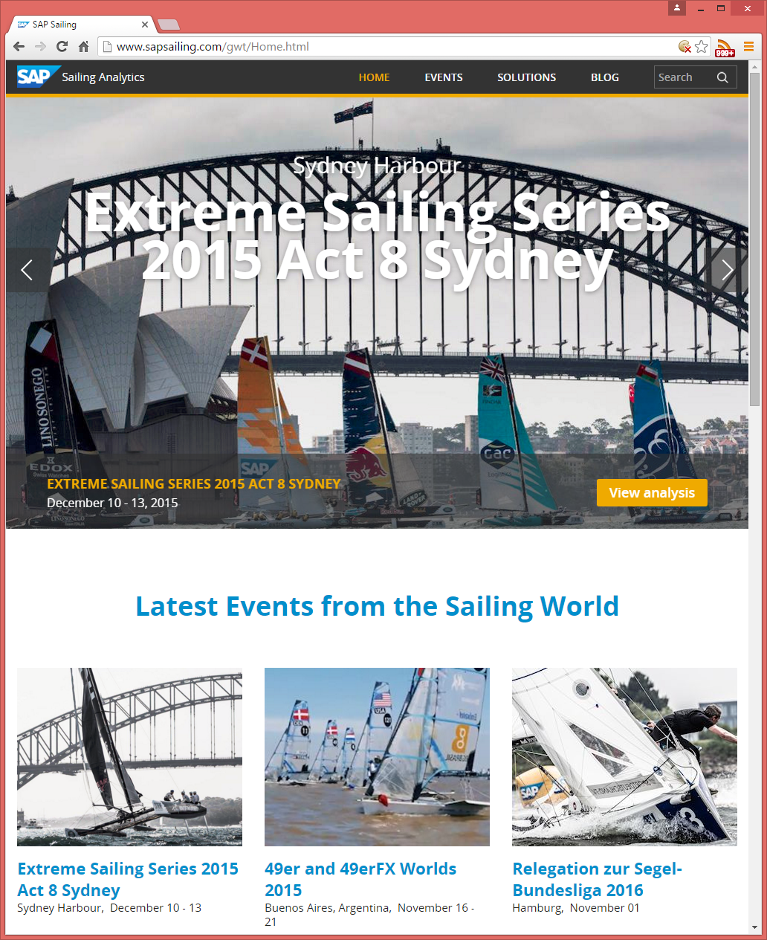
SAP Sailing Analytics – Overview
Live Events and Rich Archive for Sailing Regattas
  Hundreds of Sailing Events
  Thousands of Races Tracked
  All of them with Live Tracking at the Time
Race Management Support
  App helps organizers to stay on top of the event
  Live Scoring, Live Leaderboards, Live Analyses
  Audience Information about Schedules, Updates
So far available only to SAP-Sponsored events.
Now SAP Sailing Analytics “go Club”

Slide 6
SAP Sailing Analytics – Top Features
Live Events and Rich Archive for Sailing Regattas
  Hundreds of Sailing Events
  Thousands of Races Tracked
  All of them with Live Tracking at the Time
Race Management Support
  App helps organizers to stay on top of the event
  Live Scoring, Live Leaderboards, Live Analyses
  Audience Information about Schedules, Updates
So far available only to SAP-Sponsored Events
Now SAP Sailing Analytics “go Club”

Slide 7
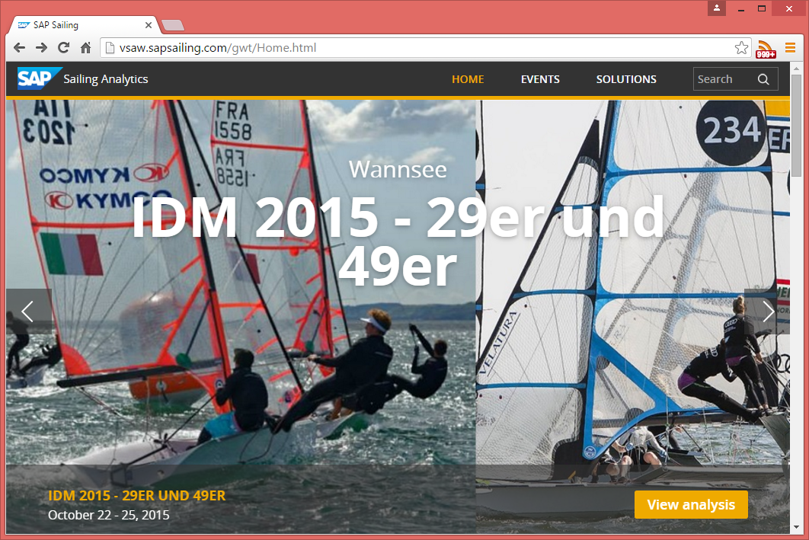
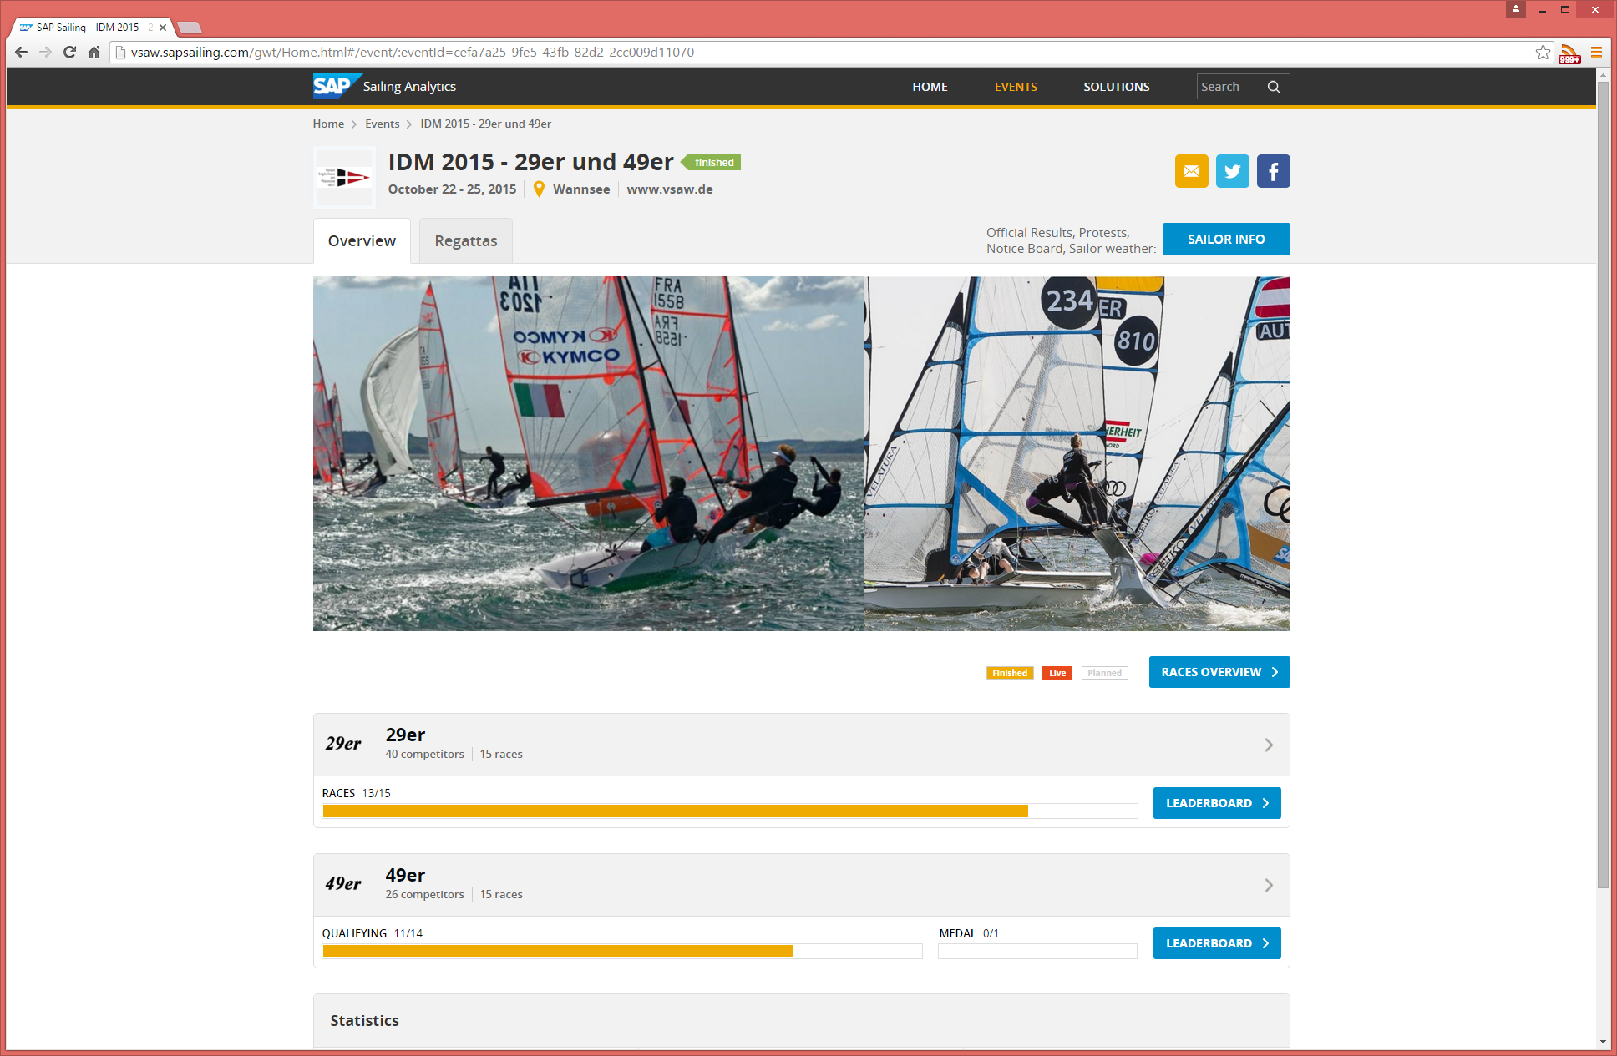
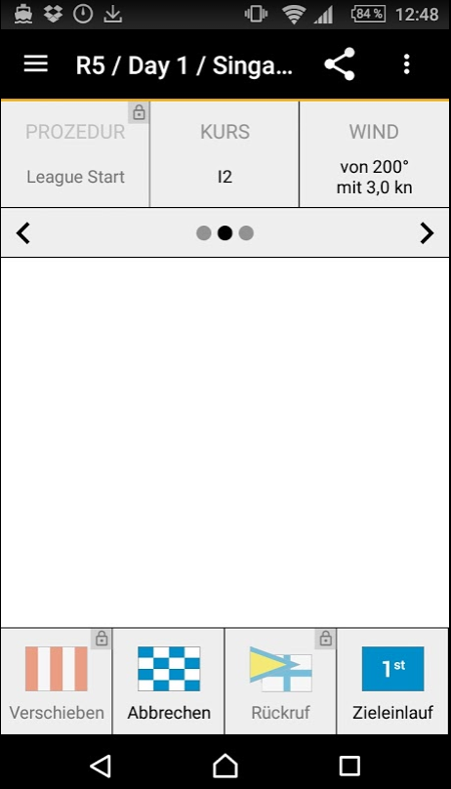
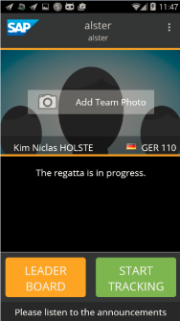
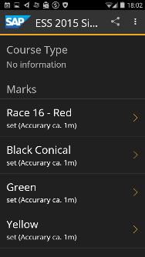
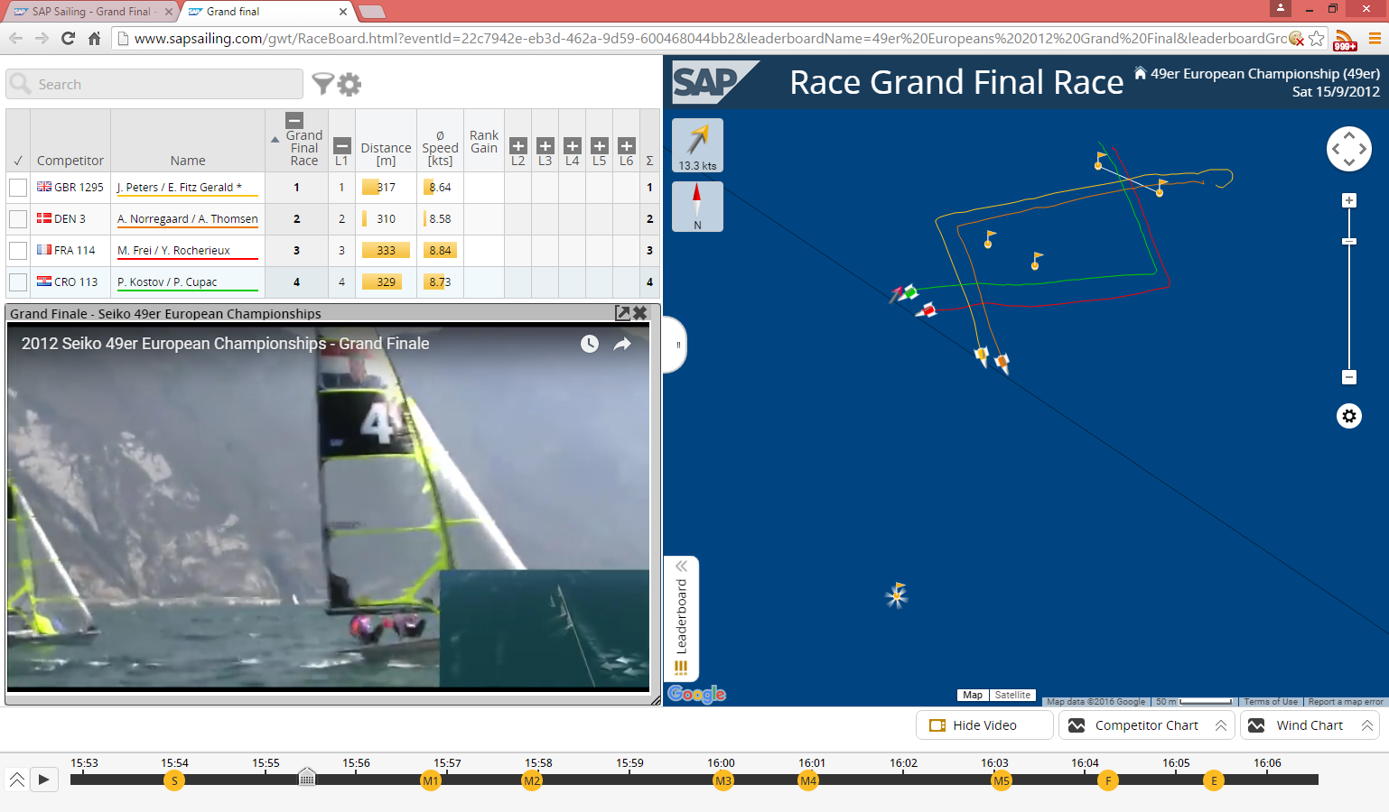
SAP Sailing Analytics – What’s in it for Your Club?
Feature your own Space
  Advertise your own Events in Nice Web Site
Manage your own Regattas
  Race Management App for Schedules / Scoring
  Keep Audience up to date
Get a Beautiful Web Site for your Event Quickly
Support Live Tracking using Smart Phones
Link Video Footage to Tracked Races

Slide 8
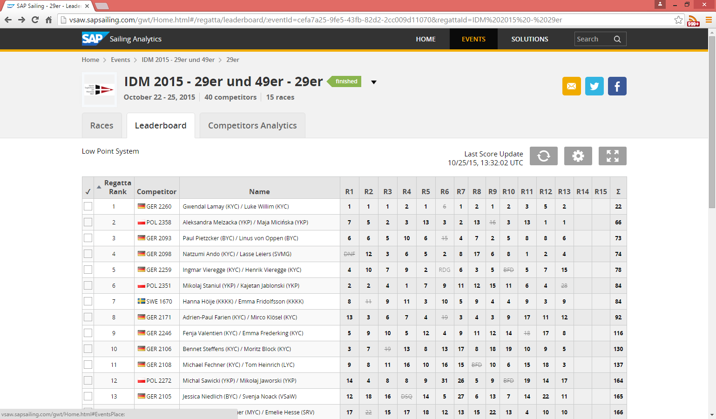
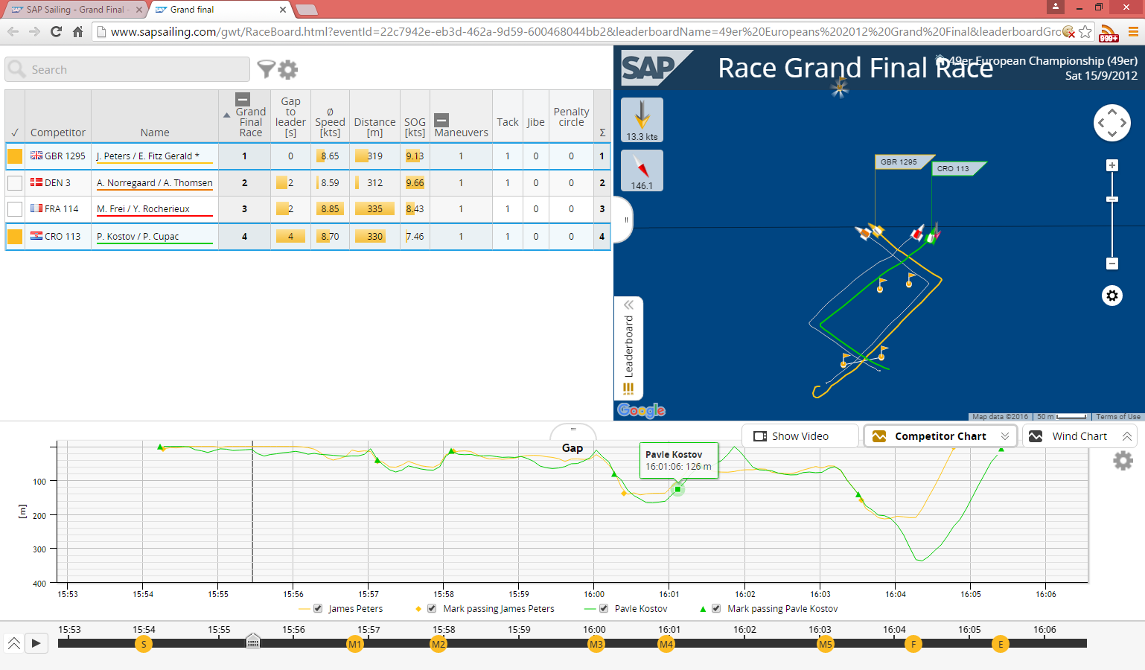
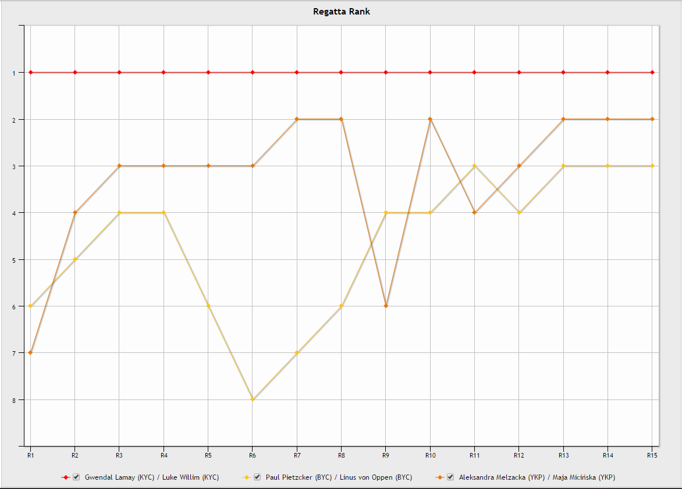
SAP Sailing Analytics – Live Leaderboards
Live Leaderboards
  Based on Race Manager App at Race Finish
  Live In-Race Ranking when Tracking in Place
  Supporting Handicap Formulas (ToT, ToD)
Live Statistics
  Ranks, Points (w/o Tracking), Gap, Speed, …

Slide 9
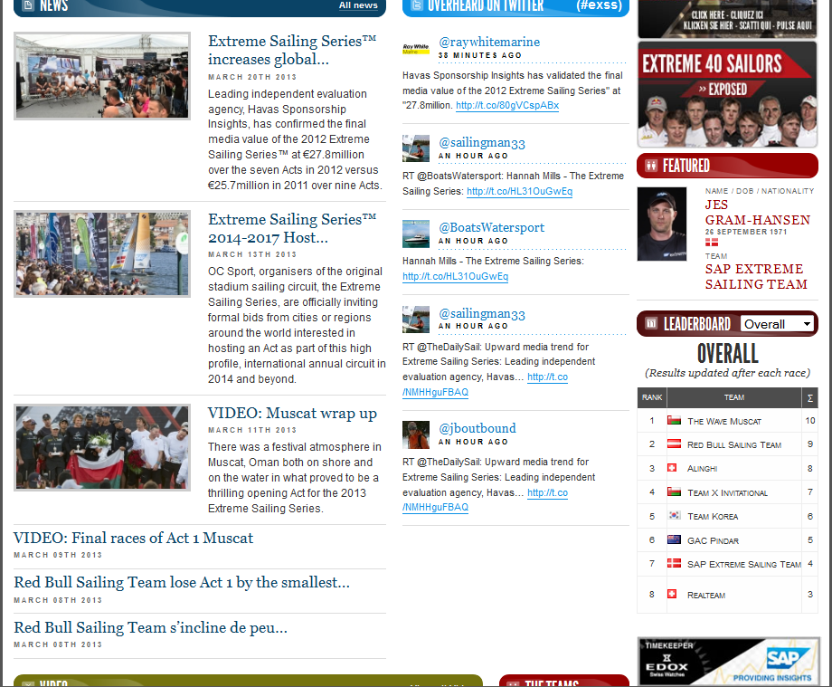
Embedding Leaderboard Content in Other Web Pages
JSON RESTlets to feed the Live Regatta and Series Leaderboards
Needs to mention SAP

Slide 10




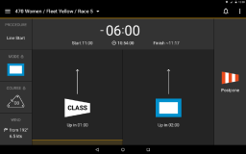
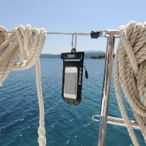
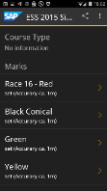


How Does It Work?
sapsailing.com
WindBot
HTTP
End User
GSM/3G
GSM/3G
HTTP
Operator
Buoy Pinging App
Race
Manager App
Sail InSight App

Slide 11
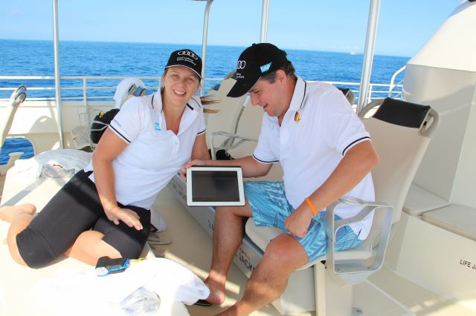
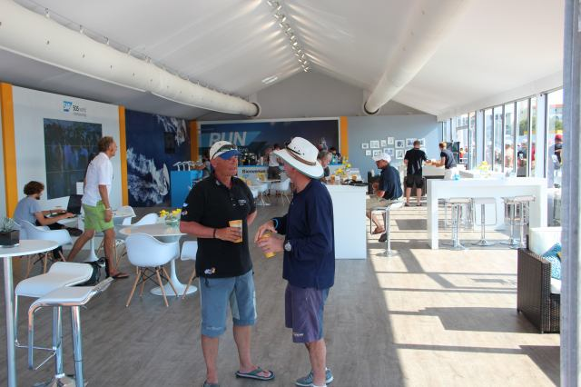
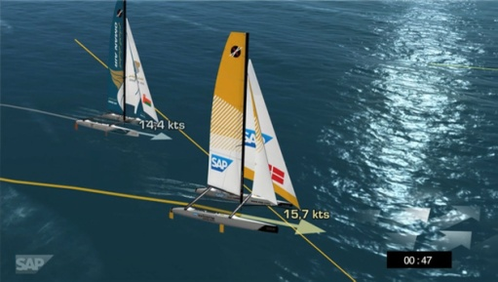
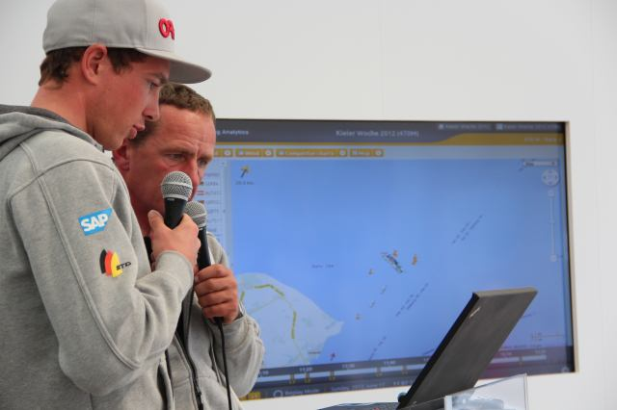
Typical Event Set-Up
Hospitality Program with Spectator Boats
    Live Race Analytics shown to spectators on tablets
Lounge, Club Facilities
    tablets, big screens, projector / canvas
On-Shore Viewers
    Online live program with scheduled racing times and course areas
    Live 2D / 3D Course and Race Visualization on shore
    Live Internet streaming with commentary
    Sailors Debrief using the SAP Sailing Analytics

Slide 12
More Background
http://www.youtube.com/watch?v=PDYLMWiB0Uw
http://www.youtube.com/watch?v=e4pUfNkrOa8
http://www.youtube.com/watch?v=w2hclkxZEoY
http://www.youtube.com/watch?v=8S2FOSWs_U0
http://www.youtube.com/watch?v=BjvSUpv6A4A
https://wiki.wdf.sap.corp/wiki/display/NWI/SAP+Sailing+Program

Slide 13
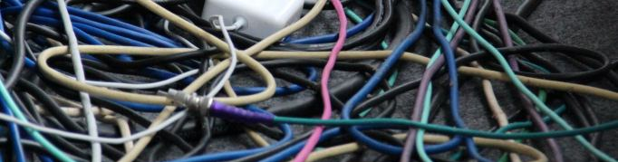
Questions?

Slide 14
Agenda
  Introduction to SAP Sailing Analytics
    Overview Functions, Features, and Architecture
  First Steps in the Administration Console
    Enabling Users
    Creating an Event
    Adding a Simple Regatta with a Leaderboard
    Adding Competitors
    Entering Scores
  Using the Race Manager App
    Binding a Device
    Logging On
    Planning and Running a Race
    Regularly Updating Wind Data

Slide 15
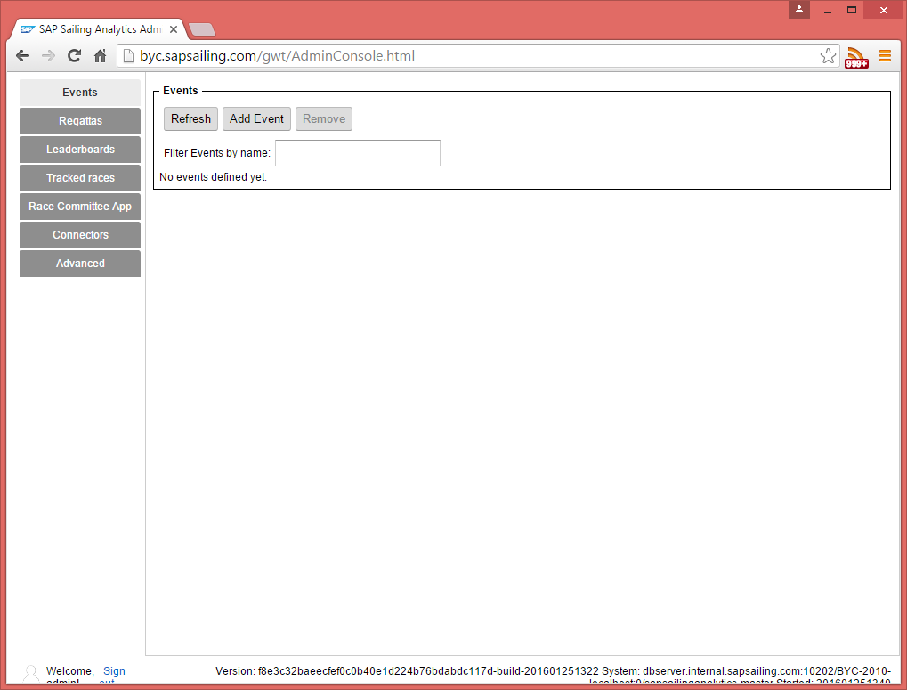
Logging On
http://yourserver.sapsailing.com/gwt/AdminConsole.html
User: admin
Password: admin
  Shows initial, empty event list
Go to Advanced→User Management

Slide 16
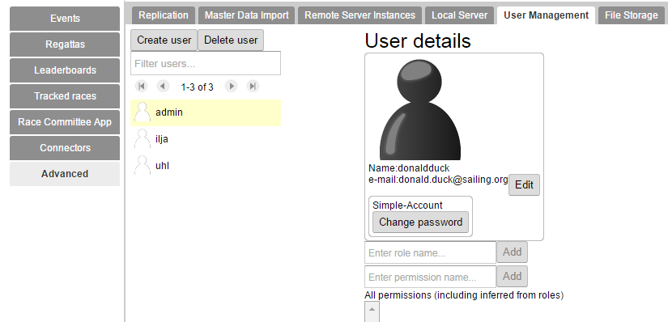
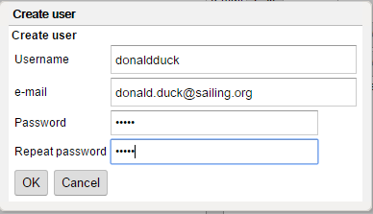
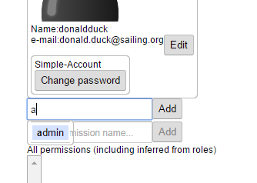
Adding and Enabling Users
Click “Create User”
Enter user details, press OK
  User receives validation e-mail
Add “admin” role for user

Slide 17
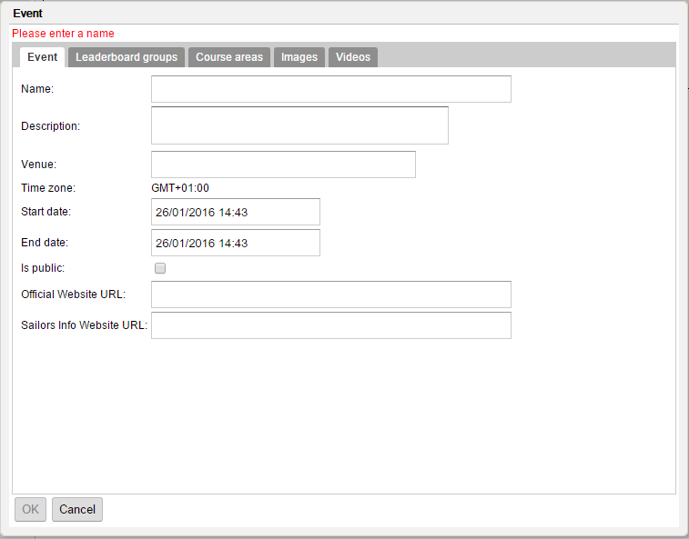
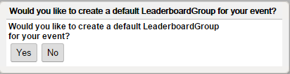
Adding an Event
In “Events” tab click “Add Event”
Fill in name, description, venue, start and end date
  A default course area
Press OK to create the event. Choose “Yes” to create
Leaderboard Group

Slide 18
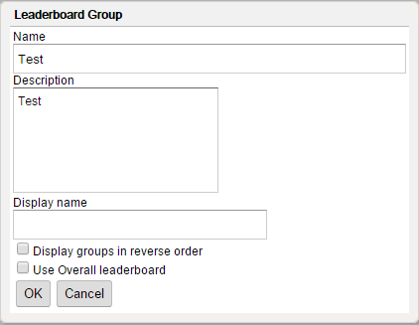
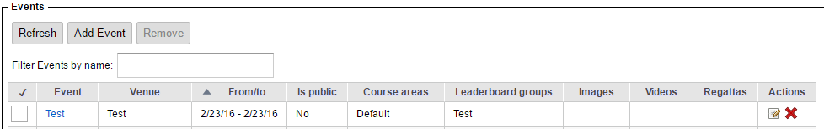
Adding a “Leaderboard Group”
A “Leaderboard Group” can describe
  A part of a larger event (e.g., “International Classes” at “Kieler Woche”)
  A series of events, such as for a league (Extreme Sailing Series, Bundesliga)
  Needed also for single-class, single event set-ups
Optionally adjust the fields
  Name (has to be globally unique)
  Description
Optionally fill in a (usually shorter) display name
Press OK
  The Leaderboard group is created and added to
  the new event

Slide 19

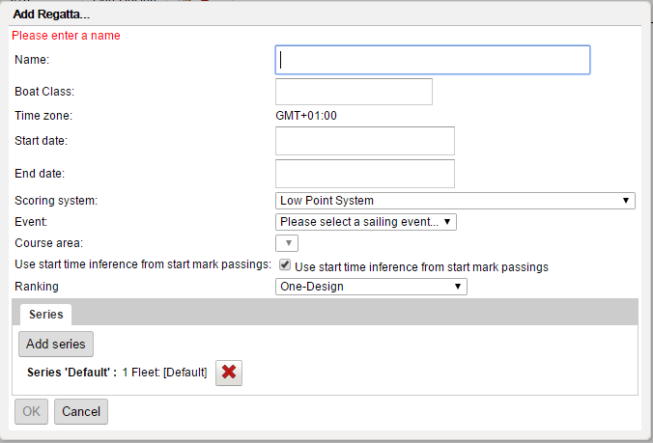
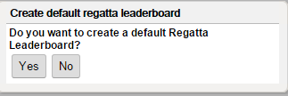
Adding a Regatta
Choose “Yes” to create a default Regatta
Fill in the fields
  Name
  Boat Class
  Event (select the one created before)
  Course Area (select the auto-created “Default”)
Press OK
Press OK on the “Add Regatta…” dialog
In the popup “Create default regatta leaderboard” press “Yes”
  The regatta has one series with one fleet and no races yet

Slide 20
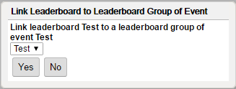
Linking Regatta Leaderboard to Event Leaderboard Group
Press OK on the popup dialog that
suggests to link the regatta leaderboard
to the event’s leaderboard group

Slide 21
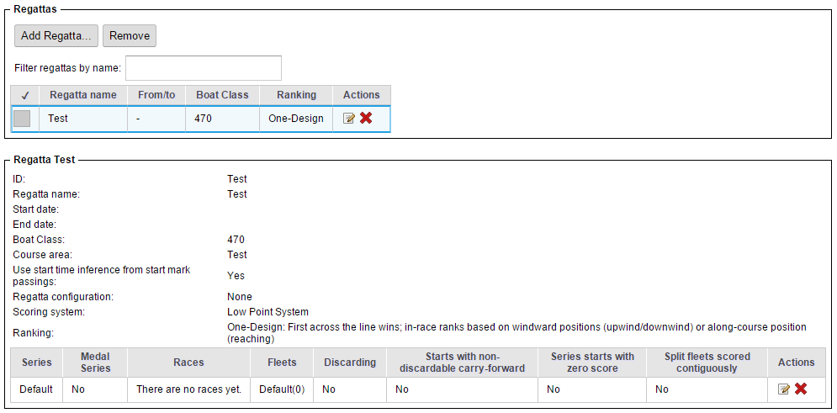
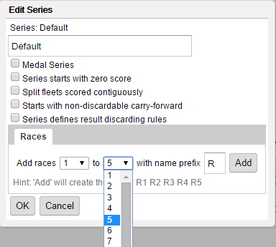
Adding Races to the Regatta
Select regatta (1)
Click “Edit” icon for Default series (2)
In the “to” drop-down, select number
of races to add (3)
Click “Add” (4)
Click “OK” (5)
1
2
3
4
5

Slide 22
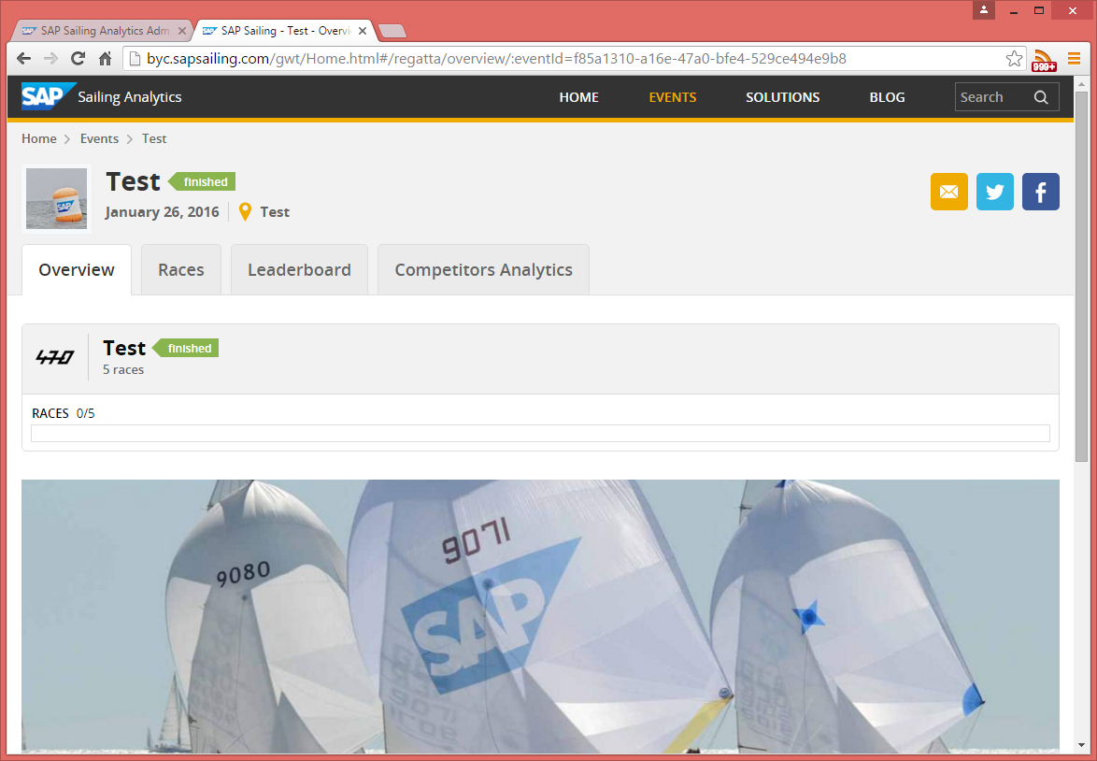
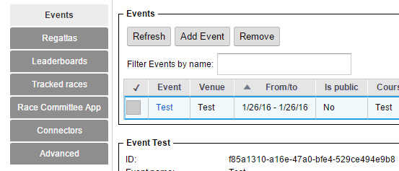
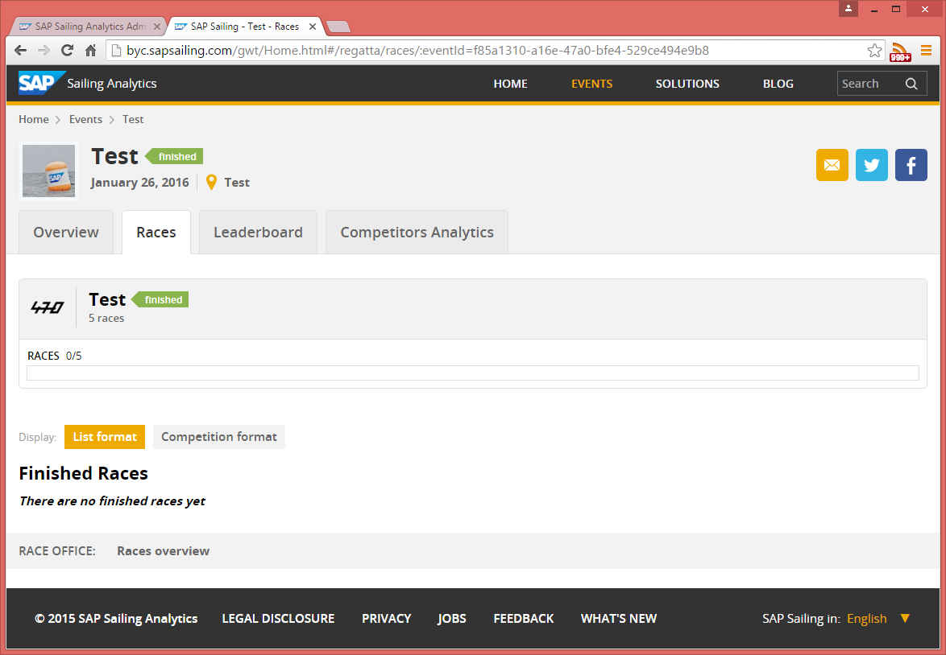
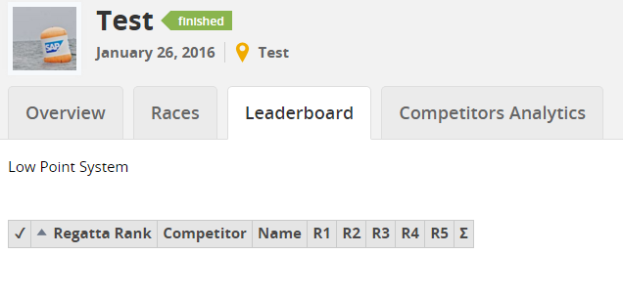
Enjoy Event Web Site
In the ”Events” tab click on event name link
This opens the event web site
  Overview shows regatta
  Generic event logo
  Generic event stage image
  Empty leaderboard with columns for races

Slide 23
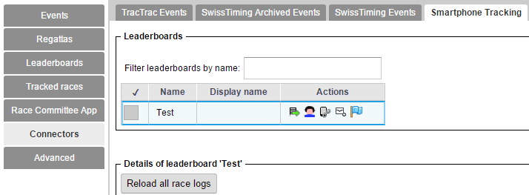
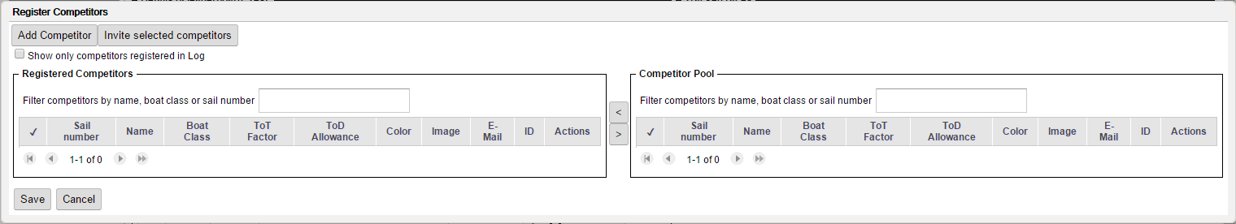
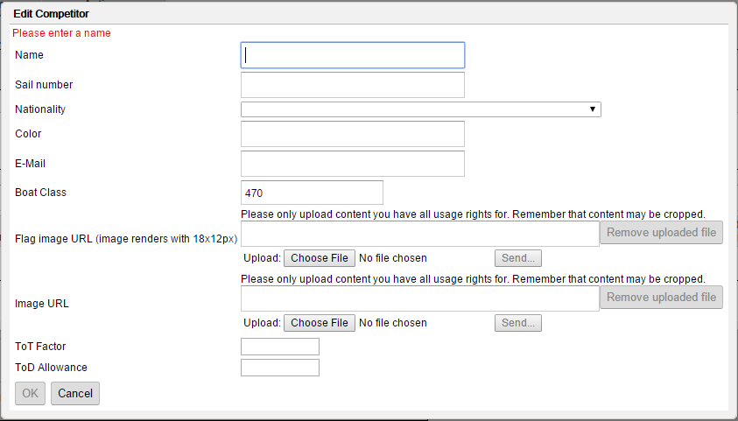
Adding Competitors
Go to Connectors→Smartphone Tracking
Click “Competitor Registrations” icon for leaderboard
Click “Add Competitor” and fill in at least
  Name
  Sail number
  Nationality
  E-Mail (if you want to invite the competitor to smartphone tracking later)
  Boat Class (pre-filled from regatta data)

Slide 24
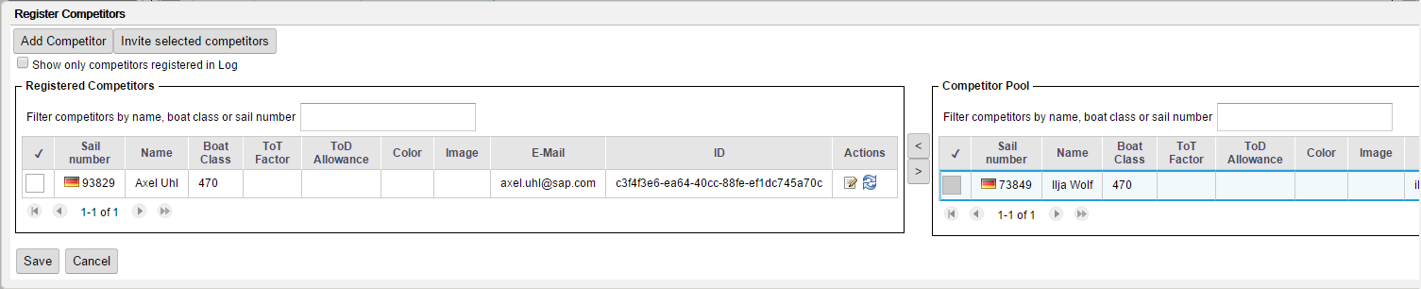
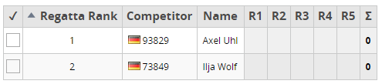
Adding Competitors (2)
Add more competitors, as required
Add existing competitors
  Select competitor in the right table (1)
  Press the “<“ button to assign competitor to leaderboard (2)
Leaderboard now shows the competitors
2
1

Slide 25
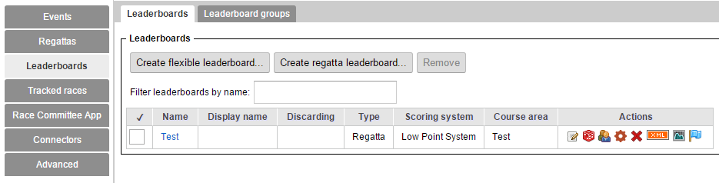
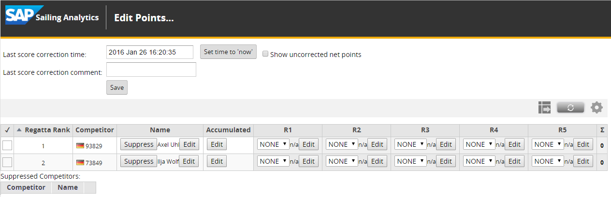
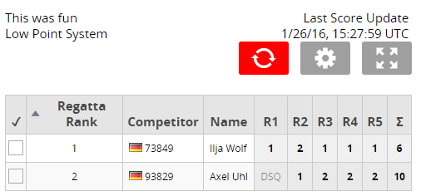
Entering Scores in Administration Console
Go to Leaderboards → Leaderboards tab
Click “Edit Scores” icon in the leaderboard’s row
Edit leaderboard contents as desired
  Competitor’s display name (1)
  Carry-over score (2)
  Scoring code, such as DSQ, OCS (3)
  Competitor’s score in race (4)
  Update time (5)
  Optional comment (6)
5
6
7
7
1
2
3
4
}
Click “Save” (7)

Slide 26
Questions?

Slide 27
Agenda
  Introduction to SAP Sailing Analytics
    Overview Functions, Features, and Architecture
  First Steps in the Administration Console
    Enabling Users
    Creating an Event
    Adding a Simple Regatta with a Leaderboard
    Adding Competitors
    Entering Scores
  Using the Race Manager App
    Binding a Device
    Logging On
    Planning and Running a Race
    Regularly Updating Wind Data

Slide 28


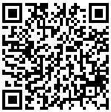

Android & iOS Apps
  SAP Sail InSight Buoy Pinging Race Management

Slide 29
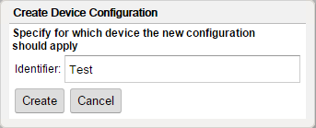
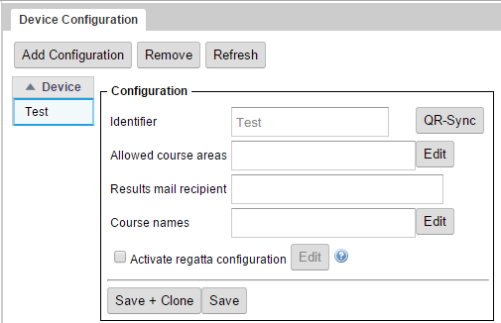
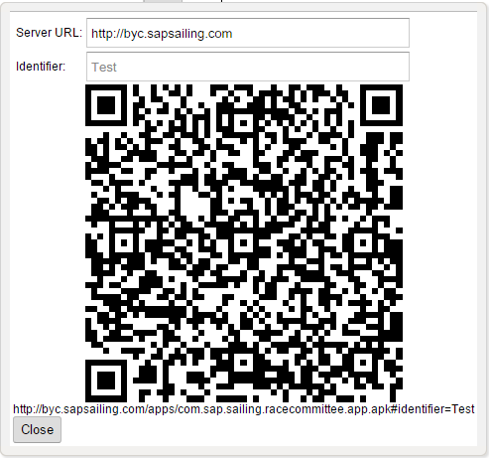
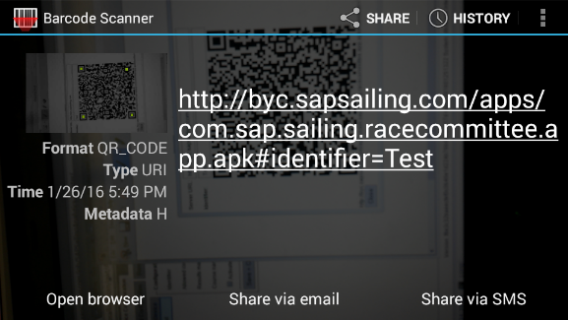

Getting the Race Manager App for Android
Go to Race Manager App → Leaderboards tab
Click “Add Configuration” and enter Identifier
Click “Create”
Click “QR-Sync”
Scan QR-Code with phone
Select “Open browser”
  App download starts
  Make sure your device allows
  apps from unknown sources
  to be installed
  Install app by tapping on
  “download finished” message

Slide 30





Binding Race Manager App to Event
Launch the app
  Starts out with a list of test events from a test server
  From the “Settings” menu select “Synchronize with Server”
  (Note: this first binding step will soon be re-named and made simpler)
  QR-Code Scanner will start
  Take snapshot of Device Configuration QR-Code again
  Confirm “Setup has changed” dialog
  Log on to your event and course area with a position

Slide 31





Scheduling a Race
Tap the race (1)
Enter a start time (2)
Enter wind information (3/4)
Confirm Setup (5)
Race timing and flags will show
  Change timing again by pressing
  the timing panel at the top
  Update start procedure, course, wind or
  start flag by swiping timing panel to the left
  Postpone, abort, recall or mark first finisher
1
2
3
4
5

Slide 32


Updating Wind Information
1
On the race sceen
  Swipe the time panel to the left (1)
  Tap on “Wind”
  Enter wind data
  Tap “Set Wind Data”
Do this frequently (every few minutes) for good results!

Slide 33






Finishing a Race
Tap the blue flag (1)
Enter the time of first ship home (2)
Tap “Down now” when last ship
home (3)
Either take snapshot of hand-written
finishing list (4)
Or enter finishing order here (5)
  Tap competitor to add to result list
  Switch to result list (on small device)
  Long-press rank to enter OCS, …
  Long-press handle and move
Optionally set protest time (6)
1
2
3
4
5
6

Slide 34
Questions?

Slide 35
Agenda
  Advanced Event and Regatta Settings
    Uploading Images and Videos
    Using the Media Gallery
    Setting Event Images for Stage, Logo and Teaser
    Regatta Format and Scoring Options
    Race Manager App Configuration (Start Procedures, Course Options, …)
    Importing Results from an External Source (e.g., Manage2Sail)
  Smartphone Tracking for Single-Fleet Regattas
    Defining the Course Marks and Waypoints
    Inviting and Binding Competitors’, Marks’ and Mark Layers’ Devices
    Using the SAP Sail InSight Tracking App
    Pinging Marks
    Starting and Stopping a Race

Slide 36





Advanced Event Configuration
Edit the Event
  Edit URLs
  Edit Images and
  Videos

Slide 37


Uploading Images and Videos
Select type of image
Input URL
  Just copy it if you have it,
  Or upload a file. This will
  fill the URL field when
  upload is complete
  Title, Subtitle and Copy-
  right are optional
  Width/Height will be filled
  automatically
Select additional tags if applicable
  Tip: press Ctrl-Space in “Enter tags for the image” field to see list of possible tags

Slide 38


Where Do the Images and Videos Appear on the Site?

Slide 39



Configuring Your Regatta
Set dates, course area
and series configuration
  Use “Add Series” for split-fleet
  set-ups
  Configure series scoring options
  Define fleets
  Use “Rank” 0 for
  qualification series
  (Yellow/Blue/… fleets)
  Use 1, 2, … for Gold,
  Silver, … fleets

Slide 40


Configuring Your Regatta – Options for Race Manager App
For non-default (P/I/Z/Black) start
mode flags, change configuration
  Choose how courses shall be
  designed in the app
  Enable start procedure(s)
  Activate/Disable individual recall
  (X will or will not be offered in app)
  Choose specific start mode flags, such as “U”
Set cross-regatta defaults in “Device Configuration”

Slide 41



Result Import from External Regatta Management System
Select “Manage2Sail XRR Result Importer” and copy the Sample URL, click “Add”
Replace event ID based on your Manage2Sail event ID

Slide 42




Importing Scores 1/2
Click “Edit Scores” icon
Click “Import Official Results”
Select provider
Select result to import

Slide 43

Importing Scores 2/2
Assign imported scores to competitors / races
  Suggestions for matching sail numbers (1)
  Suggestions based on race numbers (2)
  All suggestions can be changed at any time
  Select all, none, all of a race or all for a competitor (4)
2
4
1
4

Slide 44
Questions?

Slide 45
Agenda
  Advanced Event and Regatta Settings
    Uploading Images and Videos
    Using the Media Gallery
    Setting Event Images for Stage, Logo and Teaser
    Regatta Format and Scoring Options
    Race Manager App Configuration (Start Procedures, Course Options, …)
    Importing Results from an External Source (e.g., Manage2Sail)
  Smartphone Tracking for Single-Fleet Regattas
    Defining the Course Marks and Waypoints
    Inviting and Binding Competitors’, Marks’ and Mark Layers’ Devices
    Using the SAP Sail InSight Tracking App
    Pinging Marks
    Starting and Stopping a Race

Slide 46
Android & iOS Apps
  SAP Sail InSight Buoy Pinging Race Management

Slide 47


Defining Marks, Control Points, and Waypoints 1/2
Enable Smartphone Tracking on Regatta
For the first race, click “Define Course Layout” icon

Slide 48



Defining Marks, Control Points, and Waypoints 2/2
Add marks (1)
Assemble gates and lines from marks (2)
Combine marks, gates, and lines into waypoints (3)
  Specify how the waypoint shall be passed (4)
Save the course (5)
3
2
1
5
4

Slide 49

Copy Course to All Races
Click “Copy course and competitors
to other races” icon
Select races to copy the course to
Press OK

Slide 50



Invite Competitors to Bind their Devices
Click “Competitor Registrations” icon
Select all competitors to invite
  All competitors selected must have a
  valid e-mail address configured
Click “Invite selected competitors”
  Sends out e-mails with QR-code
  and link
Competitors
scan it

Slide 51



Produce QR Codes to Bind Devices Used to Track Marks
Click “Map Devices to Competitors
and Marks” icon
Select mark, producing QR code
Scan code with device used to track
mark

Slide 52





Enabling Use of Buoy Pinging App
Click “Invite Buoy Tenders” icon
Select event
Enter e-mail addresses for invitations
Click “Invite Buoy Tenders”
Scan code in app

Slide 53



Start Race Tracking, Set Tracking Times
Select race
Click “Start tracking” (1)
Click “Set tracking times” icon (2)
Enter at least a “Start of tracking” time
Alternatively to using
Race Manager App, click
“Set start time” icon (3)
  Set race start time
  Can be used to complement
  Race Manager app
3
2
1

Slide 54
Questions?

Slide 55
Agenda
  Smartphone Tracking for Split-Fleet Regattas
    Defining Series and Fleets in the Regatta
    Assigning Competitors to their Fleet Races
  Known Issues, Outlook
    Importing Competitors from External Regatta Management System
    Using Race Manager-Based Result Entry and External Scoring System
    Correcting Wrongly Pinged Mark Positions
    Obtaining the Apps
    User Management

Slide 56




Assigning Competitors to Fleet Races
Click “Competitor Registrations” icon (1)
Enable per-race competitor assignment (2)
Confirm (3)
Assign competitors to race (4), Save (5)
1
2
3
4
5

Slide 57
Agenda
  Smartphone Tracking for Split-Fleet Regattas
    Defining Series and Fleets in the Regatta
    Assigning Competitors to their Fleet Races
  Known Issues, Outlook
    Importing Competitors from External Regatta Management System
    Using Race Manager-Based Result Entry and External Scoring System
    Correcting Wrongly Pinged Mark Positions
    Obtaining the Apps (http://byc.sapsailing.com/apps)
    User Management

Slide 58



Thank you
Contact information:
axel.uhl@sap.com

