Slide 1
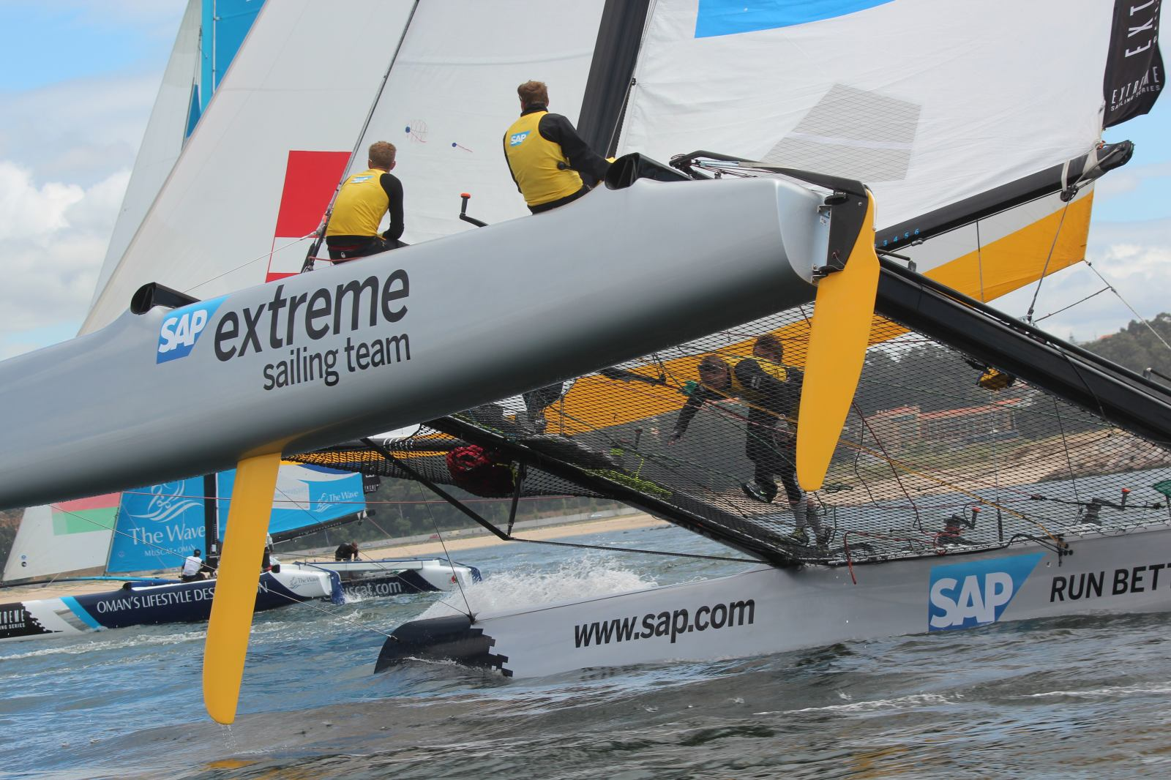

SAP Sailing Analytics
Software Architecture in a Showcase Set-Up
Axel Uhl, Global Sponsorships
September 16, 2013

Slide 2
Agenda
Introduction to SAP Global Sponsorships and SAP Sailing Analytics
Architectural Cornerstones
  Java and OSGi, GWT, JAX-RS, MongoDB
  Recording and Analyzing Real-World Data in Memory with Java
Caching and Locking in a Highly Concurrent Environment
Scaling an In-Memory Architecture with Replication

Slide 3

What is SAP Global Sponsorships About?

Slide 4


Slide 5
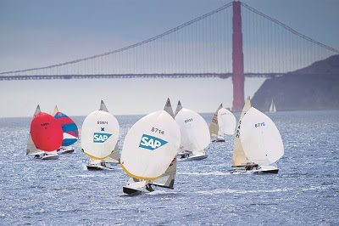

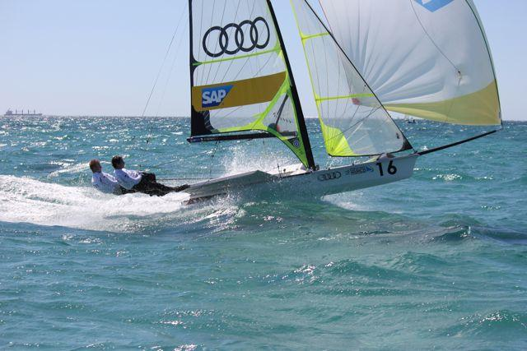
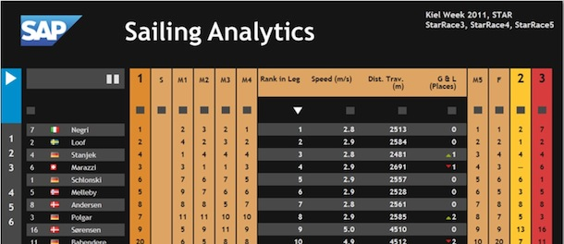
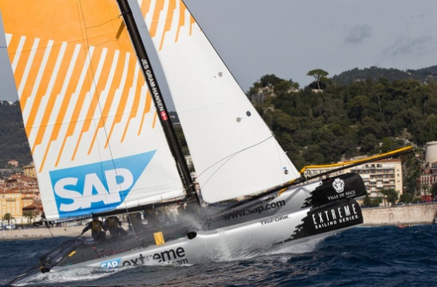
History of Sailing in Global Sponsorships
  SAP Sponsors the 5o5 Worlds Since 2009
    Hospitality Program
    Since 2010 Tracking-Based Analytics
  Kieler Woche 2011-2013
    First Live Leader Board with Basic Live Analytics in 2011 (e.g., Speeds, Distances, Wind)
  Various Smaller Events with Live Analytics
    IDM Travemünde, MdM Hamburg, Young Europeans Sailing Kiel, BMW Sailing Cup Wannsee, Berlin Match Race, Dragon IDM Wannsee, 49er Euros Lake Garda, …
  Extreme Sailing Series
    Live Analytics for the last three acts of 2012
    Official Score Keeper and Analytics Provider for the 2013 Series
  See http://sapsailing.com

Slide 6
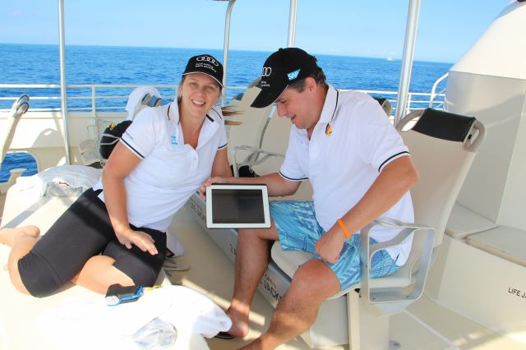
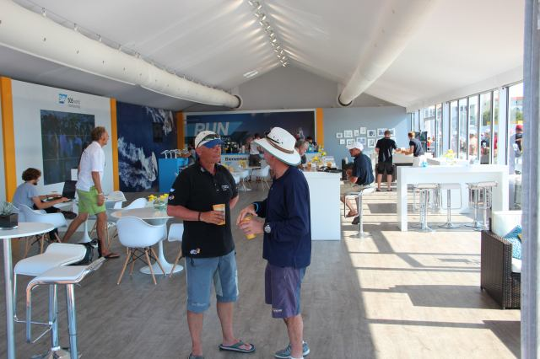
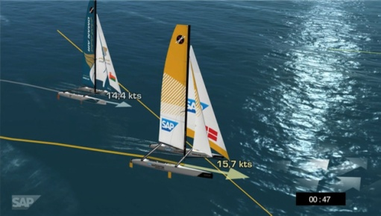
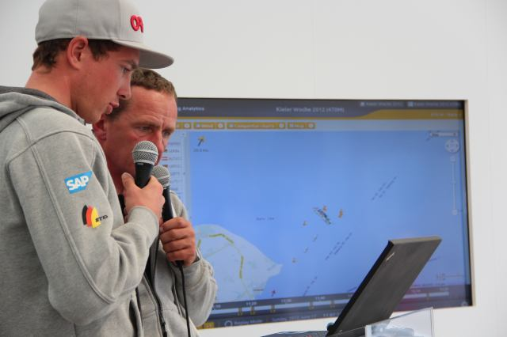
Typical Event Set-Up
Hospitality Program with Spectator Boats
    Live Race Analytics shown to spectators on tablets
Lounge
    iPads and big screens
On-Shore Viewers
    Online live program with scheduled racing times and course areas
    Live 2D / 3D Course and Race Visualization on shore
    Live Internet streaming with commentary
    Sailors Debrief using the SAP Sailing Analytics

Slide 7
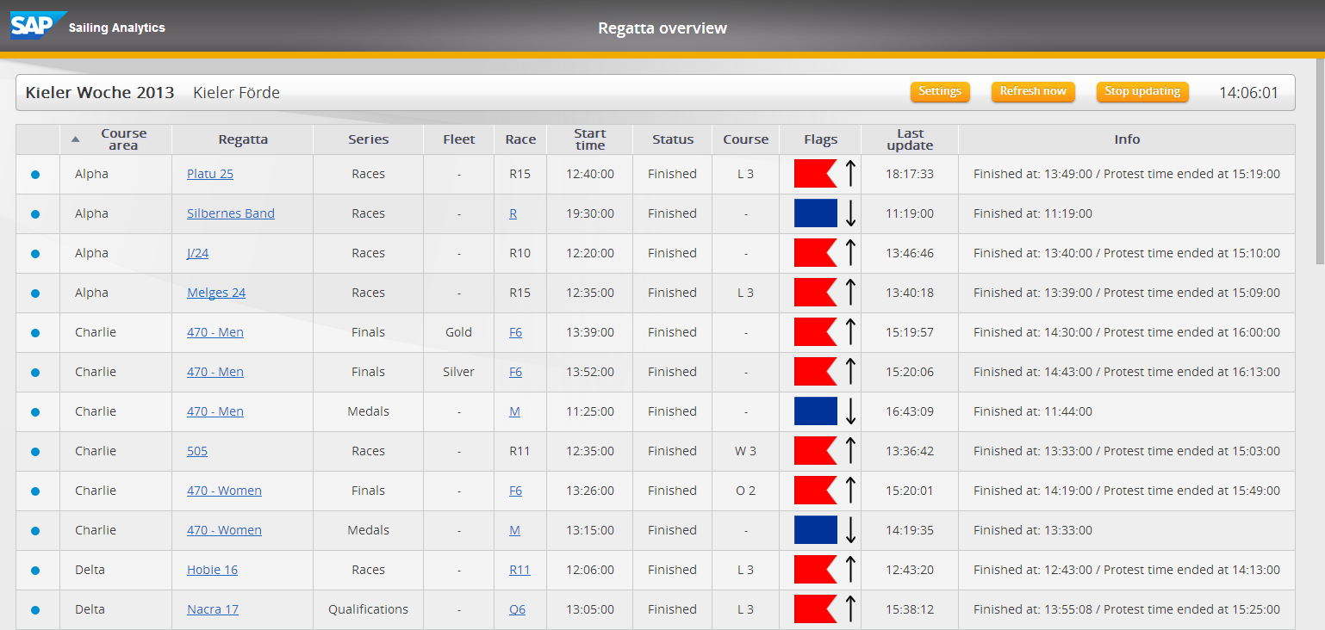
Regatta Overview
  Based on Race Committee App and SAP Sailing Analytics
    Provides overview of races and their status, linking to SAP Sailing Analytics

Slide 8
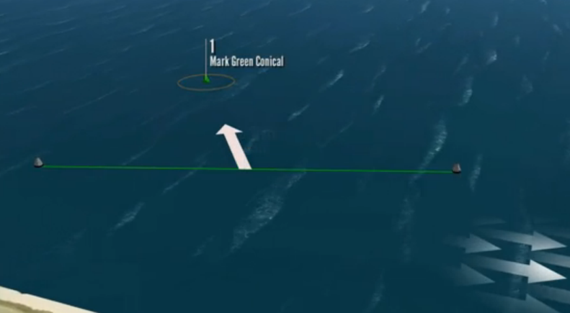
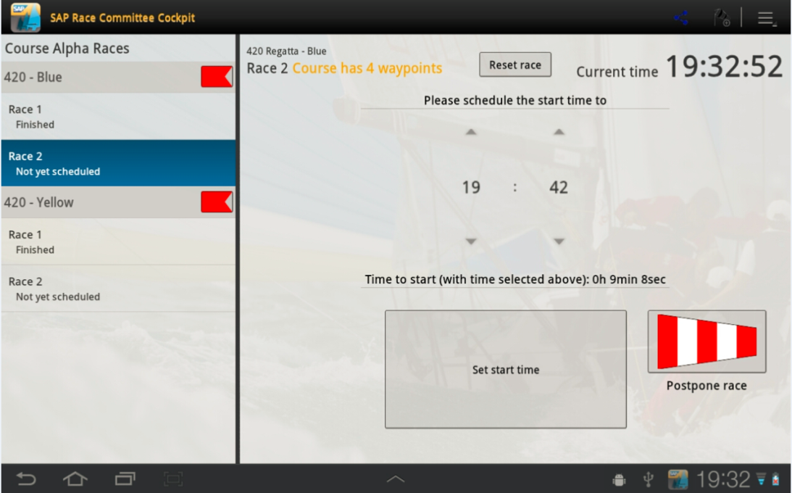
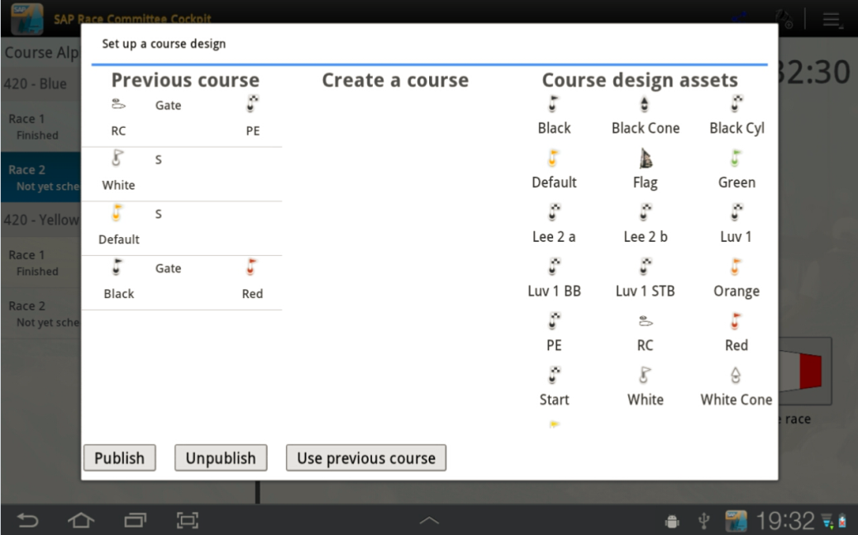
Android App for Race Committee Support
Announces Course and Race Start Time
Will be used for final result entry

Slide 9
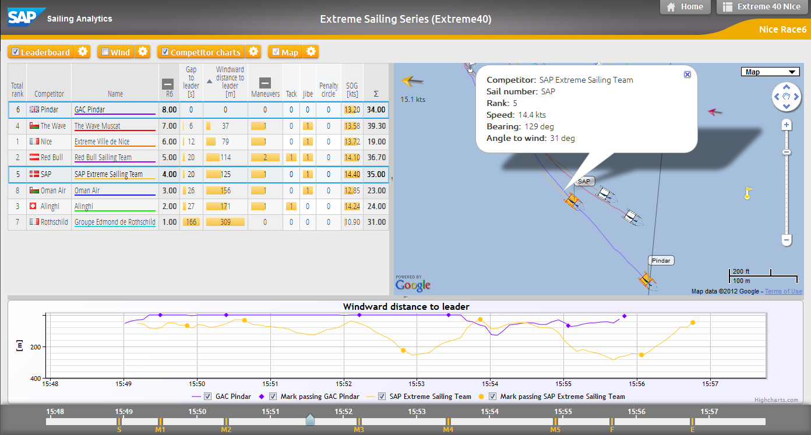
Analyzing a Single Race While It’s Live or When It’s Over

Slide 10
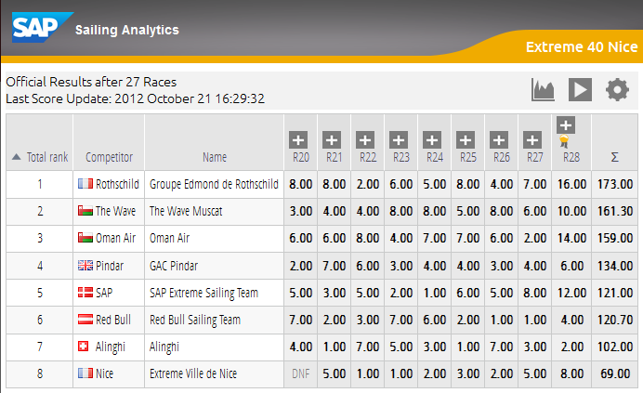
Live Regatta Leaderboard Based on Live Tracking

Slide 11
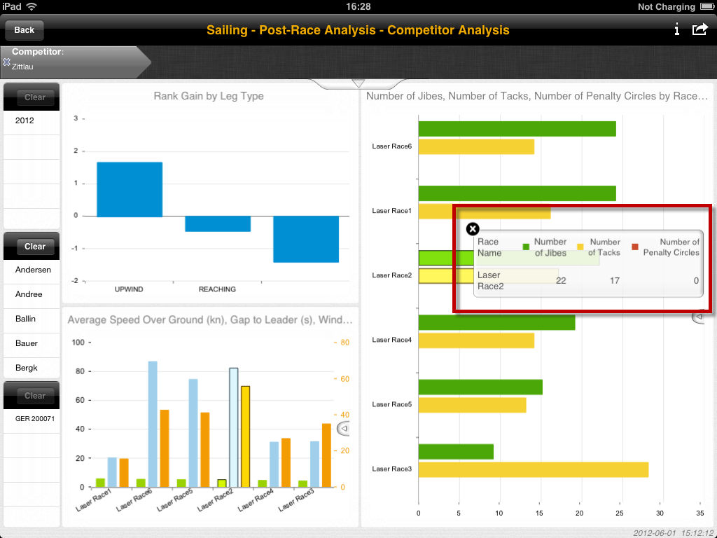
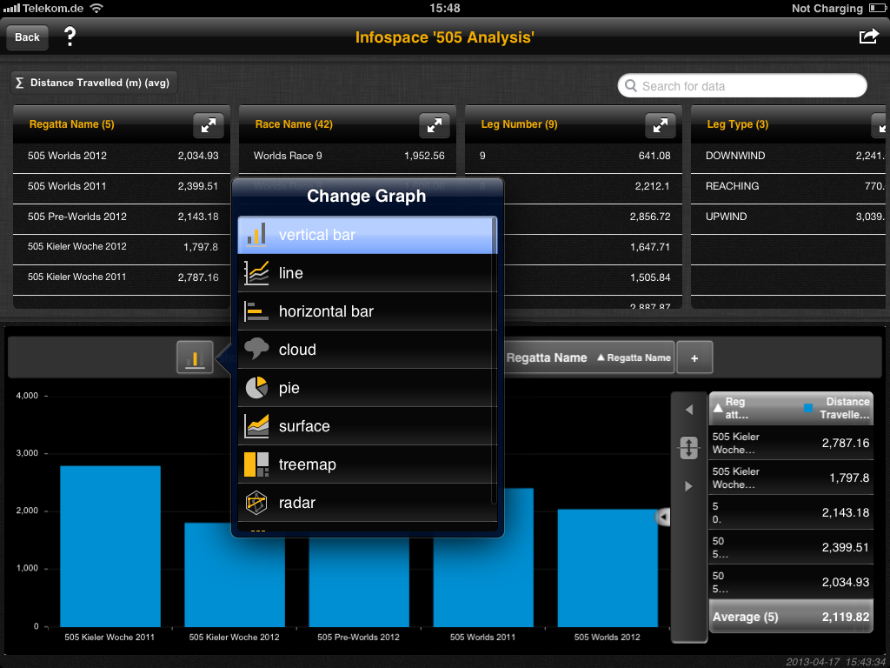
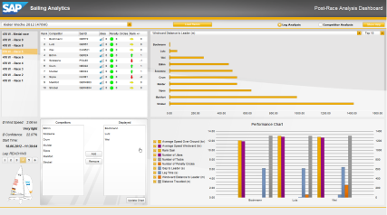
Post-Race Analytics
iPad and Desktop tools for analyzing large historic sail race database

Slide 12

Architecture Cornerstones

Slide 13




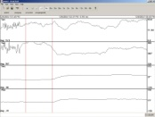





SAP Sailing Analytics System Landscape and Data Flow
sapsailing.com
Wind measurement
HTTP
Expedition
Toughbook
TCP
UDP
TCP
UDP
Mobile hotspot
GSM / GPS Boat Tracker

Slide 14
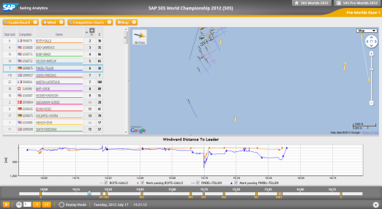

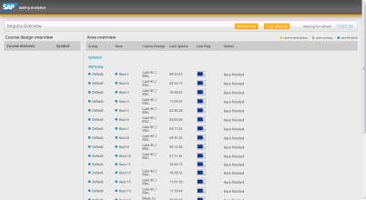
SAP Sailing Analytics and Additional Components
LIVE & Replay Mode
SAP BusinessObjects
SAP BI Platform
GPS Tracking
GPS Data
SAP Sailing Analytics
Explorer
Wind Data
SAP HANA
Wind Sensors
Dashboards
Regatta Overview
Race Committee App
LIVE
Post-Race

Slide 15
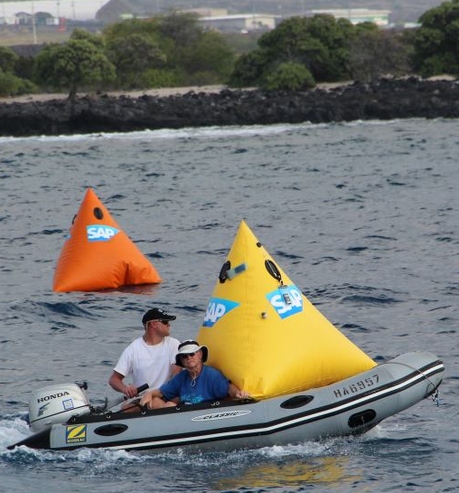
Web Application Architecture, Basic Principles
  Java with OSGi/Equinox to record and analyze live data
    Insert-only; queries aggregate on the fly
    Parallel aggregations for different key figures per query
  Embedded Jetty as Servlet/RESTlet container
    Using OSGi Web Bundles
  Apache as reverse proxy talking to several Java instances
  Google Web Toolkit (GWT)
    Cross-browser web application development in Java
    Easy code sharing between client and server
    Encapsulation, refactoring and debugging made easy
  REST/JSON interfaces for “gateway” services, JAX-RS
    Used by partners for integration with their web sites
    Used by mobile applications
    Used for extraction into HANA, showcasing BOBJ Explorer
  Git, JUnit, Maven, Hudson, Selenium, MongoDB

Slide 16

Caching and Locking in a Highly Concurrent Environment

Slide 17
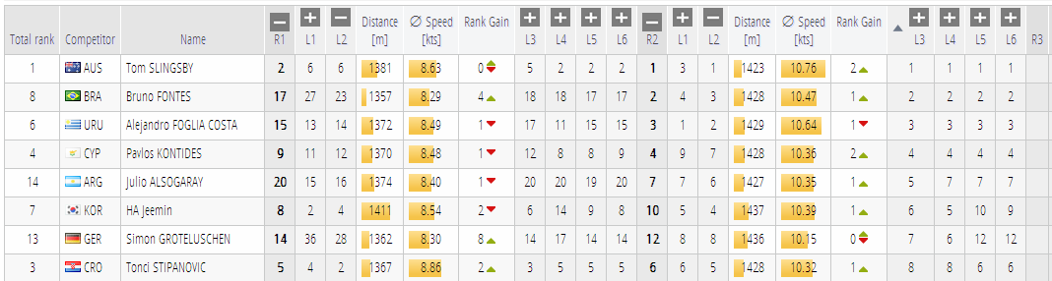
Core Computations Easily Run in Parallel
  The calculations populating each red box are executed in one task.
  Each task is assigned to an Executor and can run concurrently.
  However, sensor feeds compete with reading tasks for data structure locks.

Slide 18
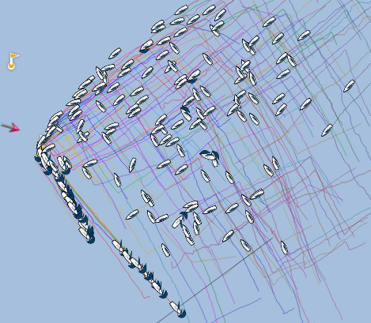
Growing Complexity, Growing Data, More Users
5o5 Worlds 2012, La Rochelle, France
    ~190 boats in one fleet, racing concurrently for two hours/race
    In addition to commentary, several users in VIP lounge and on
    tablet devices
Where “insert-only” and “aggregate on the fly” bit us
  Simple example: distance traveled for one competitor
    Find first fix at or after start line passing
    Sum up great-circle distance to the next fix that’s not an outlier
    Do this for all fixes up to query time point or end of leg / race
  For a leader-board with c=number of competitors and f=number of fixes that’s O(c*f)
    And the price per operation is quite high as it involves trigonometric functions
  Leader-board re-calculation times now >2s per request towards the end of a race
  More users started accessing our stuff → many similar expensive requests

Slide 19

Consider Caching
Major Nightmare, Pandora’s Box
    For each cached result, need to know when to invalidate cache.
    Calculation rule changes → invalidation logic needs to change
    accordingly
    Feels like re-building Excel…
    …but seems inevitable to us when calculations on raw data become more complex and number of concurrent users goes up.
Cache Invalidation with Out-of-Order Delivery
  Tricky as one needs to know the cached scope affected by a single fix.
  Example:
    Wind is calculated as weighted average 15s before and after the requested time point.
    A new wind fix will affect the average for 15s before and after its time point.

Slide 20
Best Effort Caching
All queries consider a time point with millisecond resolution.
  Makes cache hits pretty unlikely…
  …unless we manage to project some time points to a single time point
    Example: querying after last change of a race projects to end of the race (more or less)
Consolidate all Live Access
    If a client asks for “live” data, it gets what the server has, no matter the “client time”
New facts that need to invalidate a best-effort cache trigger re-calculation
    Clients continue to receive outdated results until re-calculation has finished.
    This way, clients don’t block for the sometimes expensive cache updates.

Slide 21
Locking ─ Obviously Needed with Concurrency
Use of Synchronized… collections usually too expensive.
Some consistency constraints exceed the scope of a single collection.
ReentrantReadWriteLock Learnings:
  Works much better than synchronized, allowing for concurrent reads
  Can use fair locks where needed
  Example: course updates
    Compete with almost all reading operations
    If non-fair lock were used, course update would have to wait forever
  We find managing, maintaining and testing locking really hard.
    Tracing of long-waiting locks with readers’ and writer’s stack trace very helpful
    Cross-thread lock “inheritance” helpful for some concurrent patterns, e.g. “Future”
  Surprise, surprise: Fair locks can lead to a “read-read” deadlock!

Slide 22
Scaling an In-Memory Architecture with Replication

Slide 23



Replication for Scale-Out and Fault Tolerance
sapsailing.com
Admin uses master
Expedition
replica
Toughbook
Initial load+
operations
UDP
sapsailing.com
UDP
Pound
Mobile hotspot
master
Initial load+
operations
TCP
sapsailing.com
replica
Data Center

Slide 24
Replication for Low-Latency On-Site Server
Expedition
DNS Server, Router
Toughbook
Fail-over
UDP
sapsailing.local
sapsailing.com
UDP
replicate
Mobile hotspot
master
replica
Fail-over
TCP
replicate
On-Site

Slide 25
Challenges with Replication
Initial Load
    Can take several minutes for a server with many races loaded at low bandwidth
Master Restart
    What about the replica’s state? How do they re-subscribe?
Disconnected Replica
    How to detect and how to react to temporarily or finally disconnected replica?
    How to clean up RabbitMQ queues for replica that “disappeared?”

Slide 26
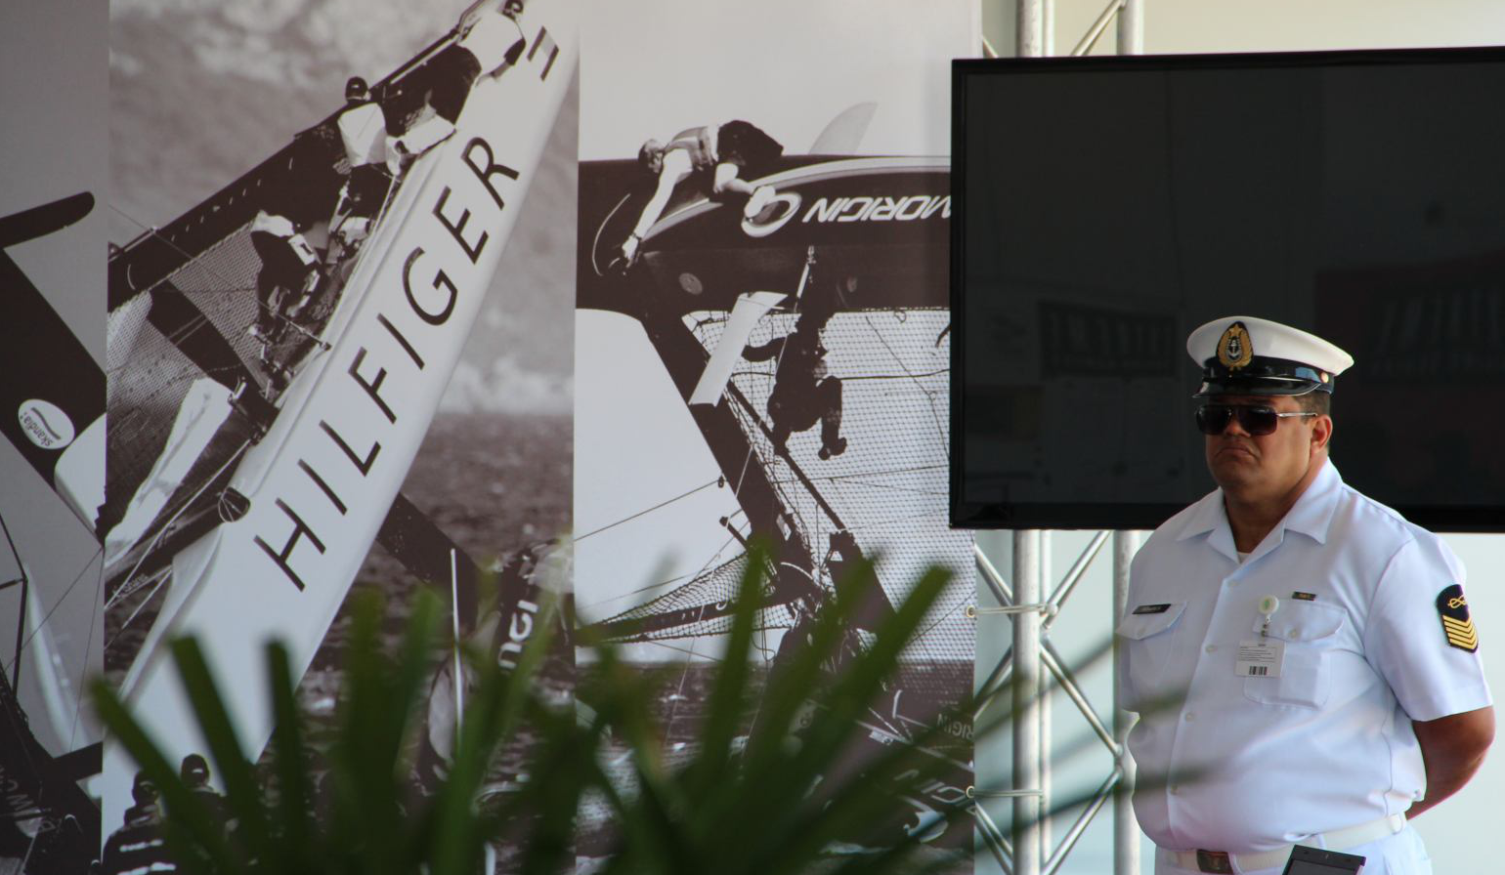
Are we Happy?

Slide 27
Summary and Outlook
From a Q&D prototype to an application with a bunch of fans and 200kLOC
    200-500 distinct users each day in-between events
    Up to 5000 distinct users per day during events
Some architectural decisions survived and are considered helpful
    Use of Java, OSGi, Web Bundles, GWT, Eclipse as useful tool environment
    In-Memory with DB as recovery-only works very well for live scenarios
    Java provides some basic means for parallelization and locking
Key Learnings
    Concurrency and locking are really hard
    In-Memory requires replication to scale and to stay available
The Things to Come
    More built-in standard analytics features, direct BOBJ link
    Continue with massive creation of UI tests with Selenium
    Smartphone Tracking to reach out to smaller sailing clubs

Slide 28
More Background
http://www.youtube.com/watch?v=PDYLMWiB0Uw
http://www.youtube.com/watch?v=e4pUfNkrOa8
http://www.youtube.com/watch?v=w2hclkxZEoY
http://www.youtube.com/watch?v=8S2FOSWs_U0
http://www.youtube.com/watch?v=BjvSUpv6A4A
https://wiki.wdf.sap.corp/wiki/display/NWI/SAP+Sailing+Program

Slide 29
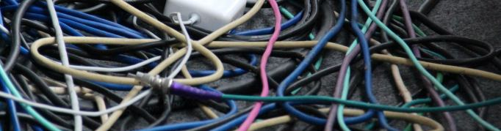
Questions?

Slide 30
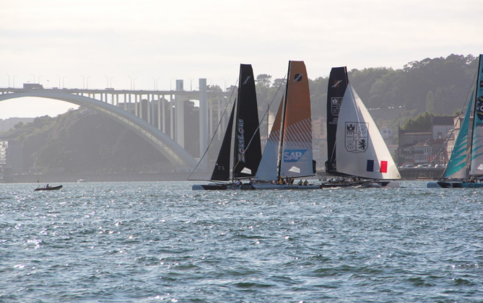

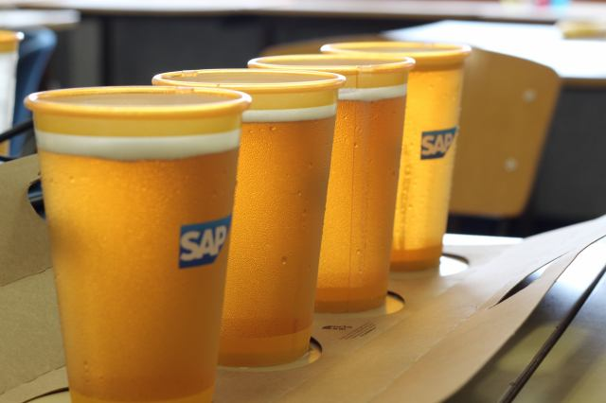
Thank you
Contact information:
axel.uhl@sap.com

Slide 31

Appendix

Slide 32

“Read-Read” Deadlock with ReentrantReadWriteLock
Thread 1
1. B.read.lock()
4. A.write.lock()
Thread 2
2. B.write.lock()
A
B
write
read
write
read
Write lock was
requested first;
need to wait for
write lock to be
granted because
lock is fair
Thread 3
3. A.read.lock()
5. B.read.lock()
    Thread 1 owns B.read and requests A.write (doesn’t get it because Thread 3 owns A.read)
    Thread 2 requests B.write (doesn’t get it because Thread 1 owns B.read)
    Thread 3 owns A.read and requests B.read (doesn’t get it because B.write came earlier)
    Looking only at Thread 1 and 3, it seems there is a deadlock between two readers of B!

Slide 33
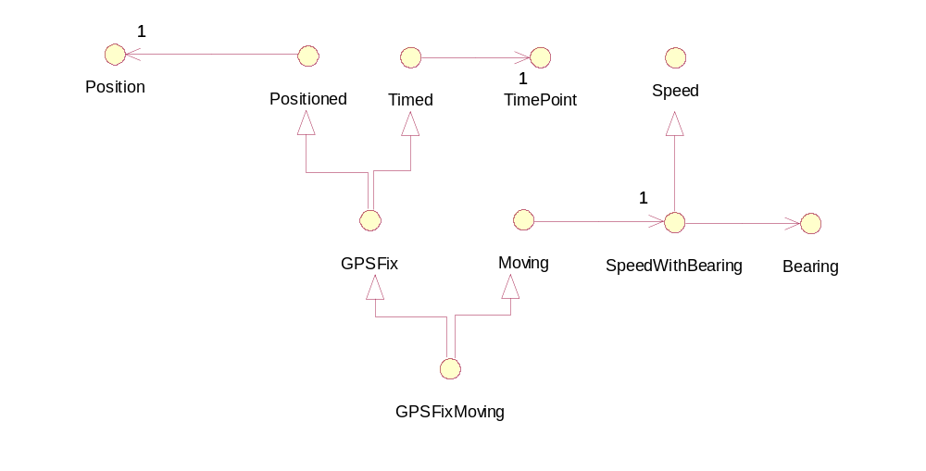
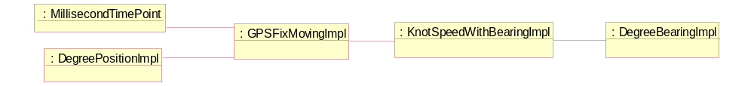
Further Performance Improvements by Saving Memory
Interfaces with naïve implementation classes → 5 objects for one GPS fix

Slide 34
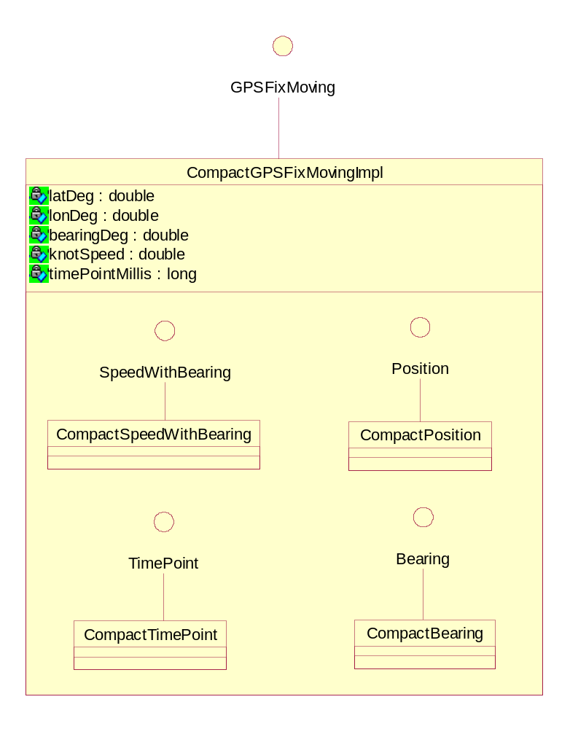
Use Compact Implementation, Saving Headers + Refs
Collect all fields of a containment hierarchy transitively
Store in one object
    Saves four object headers (4*16B=64B)
    Saves four object references (4*8B=32B)
    Payload: 5*8B=40B
    Single object header: 16B
  Leaves 40% overhead instead of 280%
Objects of inner classes only needed temporarily
    Usually end up in “Eden” space
    Quickly GCed again
    Often don’t even leave stack frame
No change at all to interfaces and clients

