Slide 1
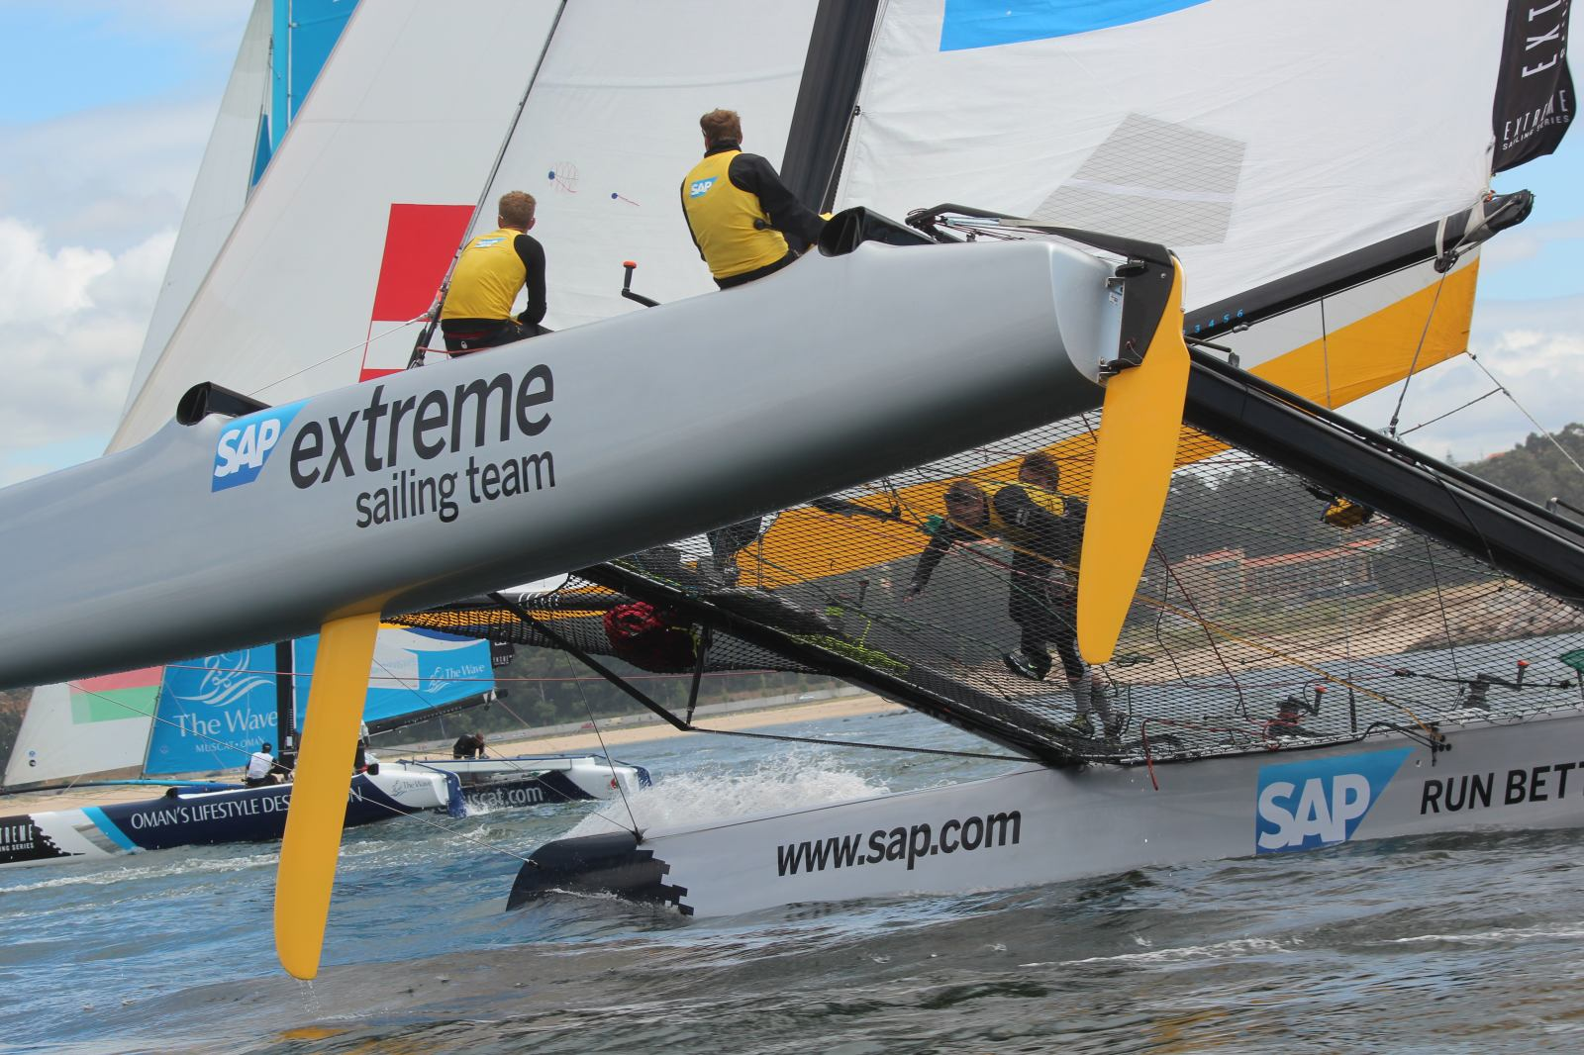

SAP Sailing Analytics
Software Architecture in a Showcase Set-Up
Axel Uhl, Global Sponsorships
March 21, 2013

Slide 2
Agenda
What is SAP Global Sponsorships About?
  History of Sailing in SAP Global Sponsorships
  From Kieler Woche 2011 to the 5o5 Worlds 2013 in Barbados
Laying the Cornerstones
  Java and OSGi, Git, Maven, MongoDB
  Recording and Analyzing Real-World Data in Memory with Java
Replacing a UI Layer
  From a Python-based Web UI to GWT
  Using OSGi Web Bundles
Caching and Locking in a Highly Concurrent Environment
Scaling an In-Memory Architecture with Replication

Slide 3

What is SAP Global Sponsorships About?

Slide 4


Slide 5
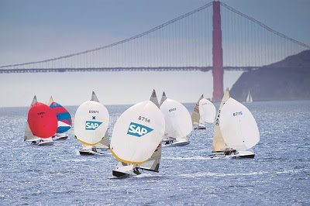

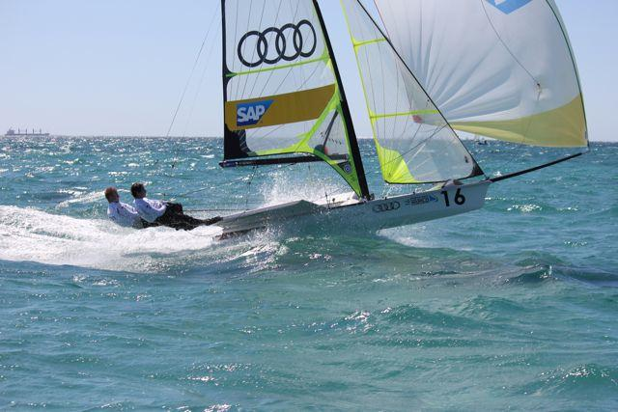
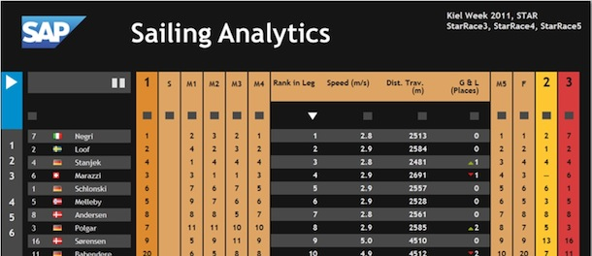
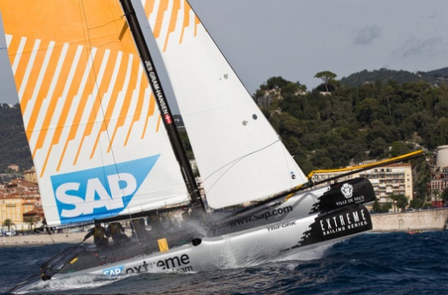
History of Sailing in Global Sponsorships
  SAP Sponsors the 5o5 Worlds Since 2009
    Hospitality Program
    Since 2010 Tracking-Based Analytics
  Kieler Woche 2011-2012
    First Live Leader Board with Basic Live Analytics (e.g., Speeds, Distances, Wind)
  Various Smaller Events with Live Analytics
    IDM Travemünde, MdM Hamburg, Young Europeans Sailing Kiel, BMW Sailing Cup Wannsee, Berlin Match Race, Dragon IDM Wannsee, 49er Euros Lake Garda
  Extreme Sailing Series
    Live Analytics for the last three acts of 2012
    Official Score Keeper and Analytics Provider for the 2013 Series
  See http://sapsailing.com

Slide 6

Gathering Live Data from Sailing Boats

Slide 7

Quick Introduction

Slide 8
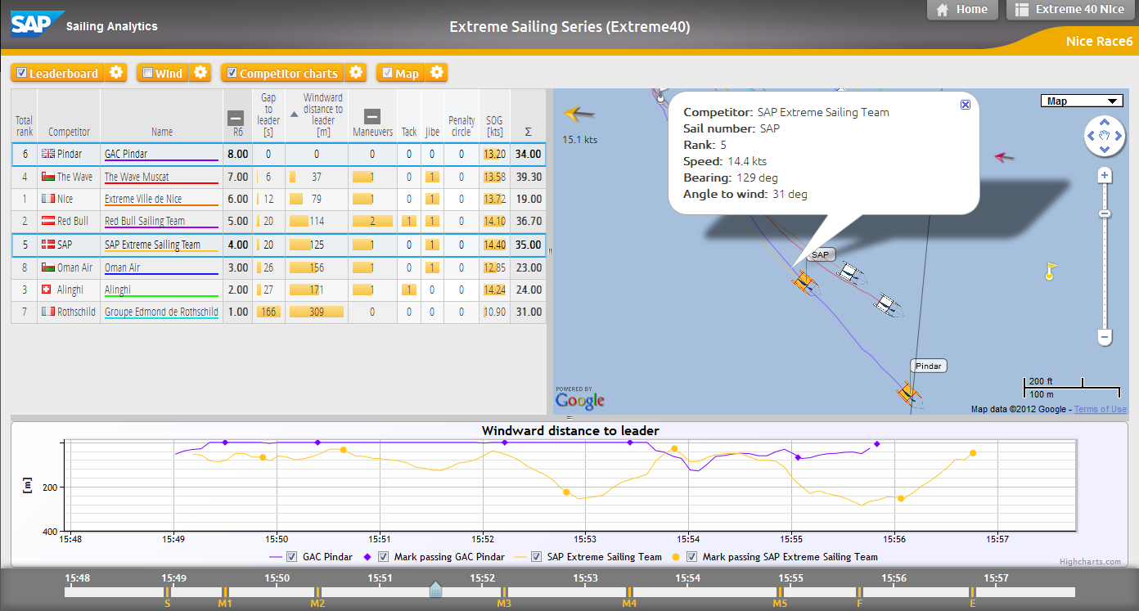
Analyzing a Single Race While It’s Live

Slide 9
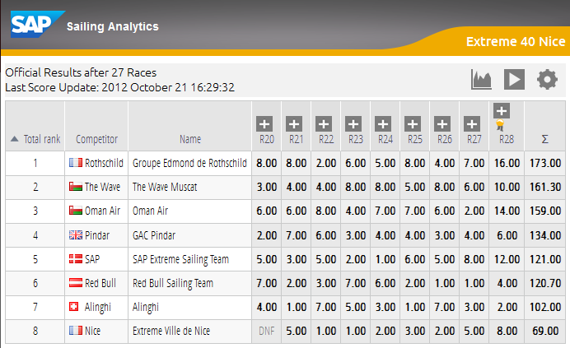
Live Regatta Leaderboard Based on Live Tracking

Slide 10
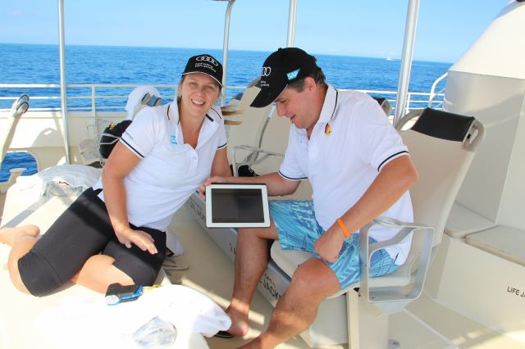
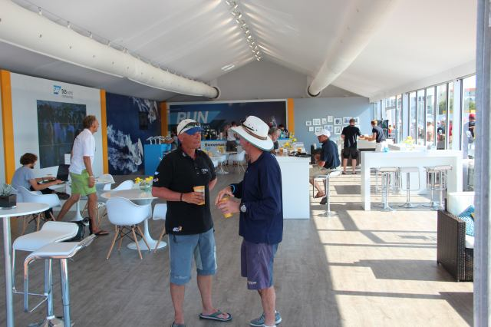
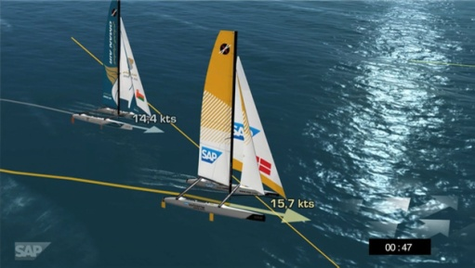
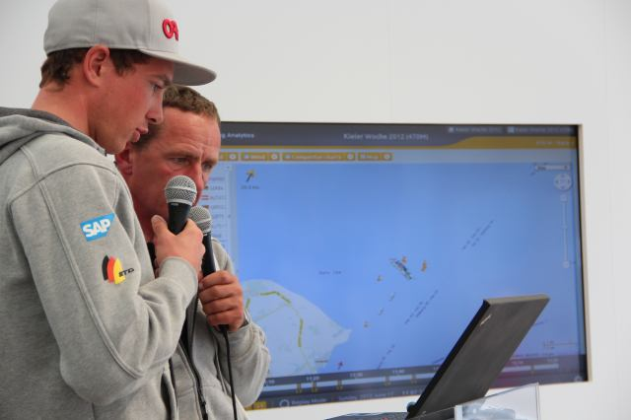
Typical Event Set-Up
Hospitality Program with Spectator Boats
    Live Race Analytics shown to spectators on tablets
Lounge
    iPads and big screens
On-Shore Viewers
    Online live program with scheduled racing times and course areas
    Live 2D / 3D Course and Race Visualization on shore
    Live Internet streaming with commentary
    Sailors Debrief using the SAP Sailing Analytics

Slide 11

Laying the Cornerstones

Slide 12


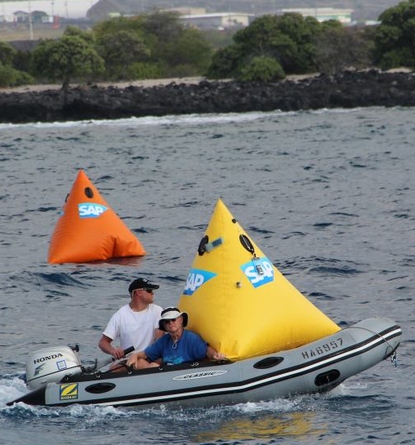
Started with Kieler Woche 2011 Requirements
Handle Live GPS and Wind Data
    Calculate Live In-Race Ranking Based on Wind and Boat Positions
    Provide Live Statistics about Distances, Speeds, Rank Changes, ETA
Choices for a Quick Prototype
  Java with OSGi/Equinox to record and analyze live data
    Insert-only; queries aggregate on the fly
    Parallel aggregations for different key figures per query
    Coarse-grained used of synchronized as Q&D “locking”
    Rendered JSON for multi-race leader-board in <10ms
  Embedded Jetty as Servlet/RESTlet container
    Explicit registration of RESTlets in bundle activator
  Python to render HTML front-end
  REST/JSON interfaces between Python and Java
  Git, JUnit, Maven, Hudson, MongoDB

Slide 13



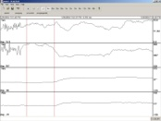




Kieler Woche 2011 System Landscape, Data Flow
sapsailing.com
HTTP
Expedition
Toughbook
TCP
UDP
TCP
UDP
Mobile hotspot
GSM / GPS Boat Tracker

Slide 14
Inside sapsailing.com
sapsailing.com
Apache
External requests
for JSON documents
possible
Java Equinox
Python
MongoDB
Wind and config data

Slide 15
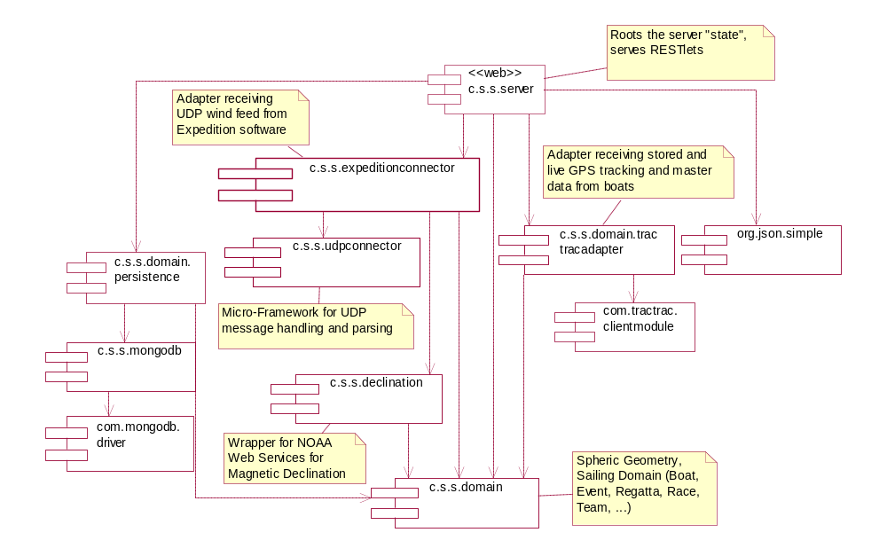
Early Bundles Living Inside the Java Server

Slide 16
Produced this Output after Four Weeks

Slide 17
Evaluation of First Prototype
UI layer
    Python server instance somehow redundant → move to GWT, eliminate Python instance
    Several usability glitches, but potential of live web-based solution already became evident
In-Memory On-the-Fly Aggregation
    Works nicely, particularly for out-of-order delivery of GPS and wind data
    Parallel execution results in nice speed-up for large leader-boards
    Use of synchronized as poor-man’s locking replacement doesn’t scale, particularly because of read-read lock-out → move to ReentrantReadWriteLock
    First few key figures were well-chosen → add more, exciting figures for sailors
    Front-end used only by one or two users so far → scaling to many users so far not required
Use of DB mostly for Recovery Only
    Works well for the data volumes we face so far. All tracking of Kieler Woche takes less than 1GB of Java heap space.

Slide 18
Replacing a UI Layer
  From a Python-Based Web UI to GWT

Slide 19
Google Web Toolkit (GWT)
Allows Java developers to build rich, dynamic HTML5 applications
    Cross-compiles Java to efficient JavaScript
    Uses the Eclipse Java debugging infrastructure
    Can be made play reasonably well with OSGi
    Code can be shared between server and browser if a few constraints are obeyed
    Powerful Eclipse JDT features available also for browser code
    Sufficient CSS styling capabilities to keep pure web designers reasonably happy
New versions of the leader-board and administration console
    Removes Python server instance
    Runs more efficiently because more can be done in the browser more easily

Slide 20
Leaderboard as Re-Built with GWT

Slide 21
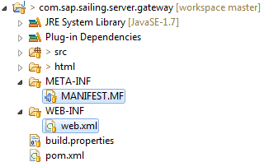

Switched from Explicit Registration to OSGi Web Bundles
Turned all Servlet/RESTlet providers into OSGi Web Bundles
    No longer requires explicit registration in activator
    Bundle start/stop and registration / deregistration handled automatically
    Easily supports exposing static web content
Easy compatible upgrades of UI and gateway bundles in running server
    Helpful if server state is a bit expensive to re-construct after start-up
In MANIFEST.MF

Slide 22
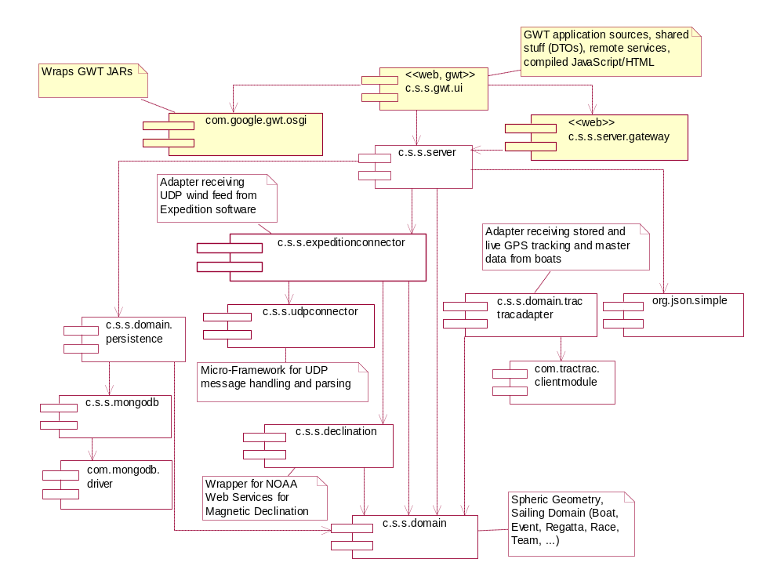
GWT Bundles in OSGi

Slide 23
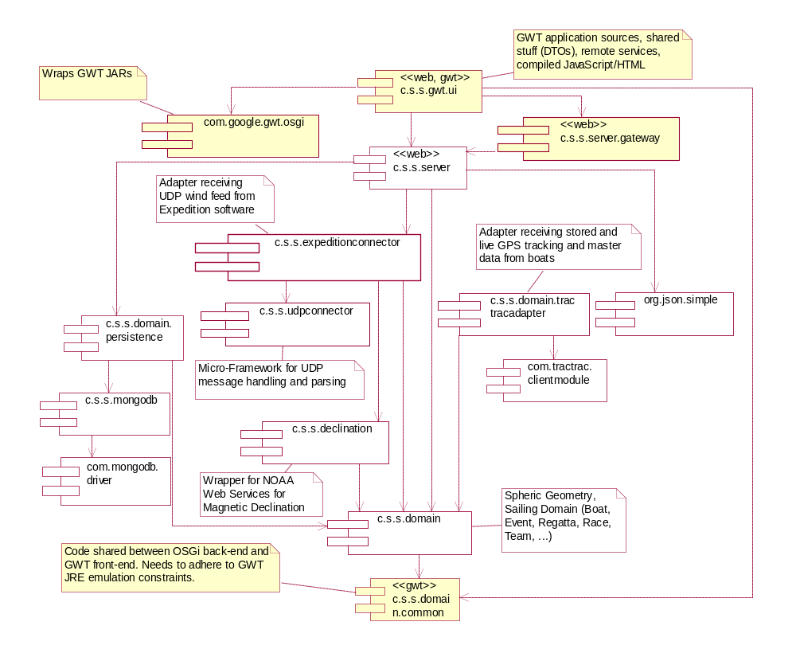
Sharing Bundles Between OSGi and GWT

Slide 24

Caching and Locking in a Highly Concurrent Environment

Slide 25
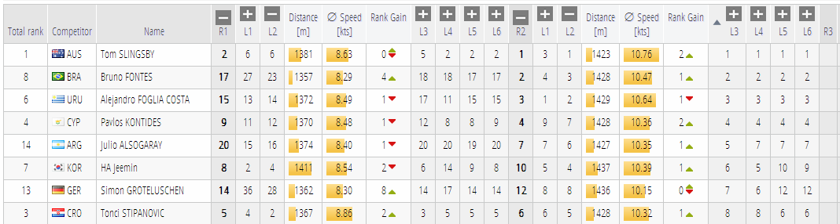
Core Computations Easily Run in Parallel
  The calculations populating each red box are executed in one task.
  Each task is assigned to an Executor and can run concurrently.
  However, sensor feeds compete with reading tasks for data structure locks.

Slide 26
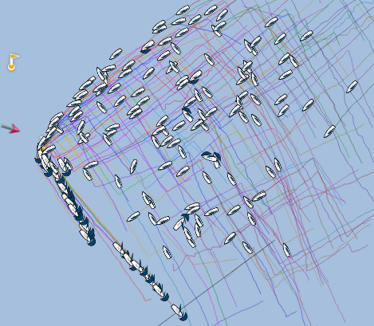
Growing Complexity, Growing Data, More Users
5o5 Worlds 2012, La Rochelle, France
    ~190 boats in one fleet, racing concurrently for two hours/race
    In addition to commentary, several users in VIP lounge and on
    tablet devices
Where “insert-only” and “aggregate on the fly” bit us
  Simple example: distance traveled for one competitor
    Find first fix at or after start line passing
    Sum up great-circle distance to the next fix that’s not an outlier
    Do this for all fixes up to query time point or end of leg / race
  For a leader-board with c=number of competitors and f=number of fixes that’s O(c*f)
    And the price per operation is quite high as it involves trigonometric functions
  Leader-board re-calculation times now >2s per request towards the end of a race
  More users started accessing our stuff → many similar expensive requests

Slide 27

Consider Caching
Major Nightmare, Pandora’s Box
    For each cached result, need to remember when to invalidate cache.
    Calculation rule changes → invalidation logic needs to change
    accordingly
    Feels like re-building Excel…
    …but seems inevitable to us when calculations on raw data become more complex and number of concurrent users goes up.
Cache Invalidation with Out-of-Order Delivery
  Tricky as one needs to know the cached scope affected by a single fix.
  Example:
    Wind is calculated as weighted average 15s before and after the requested time point.
    A new wind fix will affect the average for 15s before and after its time point.

Slide 28
Best Effort Caching
All queries consider a time point with millisecond resolution.
  Makes cache hits pretty unlikely…
  …unless we manage to project some time points to a single time point
    Example: querying after last change of a race projects to end of the race (more or less)
Consolidate all Live Access
    If a client asks for “live” data, it gets what the server has, no matter the “client time”
New facts that need to invalidate a best-effort cache trigger re-calculation
    Clients continue to receive outdated results until re-calculation has finished.
    This way, clients don’t block for the sometimes expensive cache updates.

Slide 29
Locking ─ Obviously Needed with Concurrency
Use of Synchronized… collections usually too expensive.
Some consistency constraints exceed a single collection.
ReentrantReadWriteLock Learnings:
  Works much better than synchronized, allowing for concurrent reads
  Can use fair locks where needed
  Example: course updates
    Compete with almost all reading operations
    If non-fair lock were used, course update would have to wait forever
  We find managing, maintaining and testing locking really hard.
    Tracing of long-waiting locks with readers’ and writer’s stack trace very helpful
  Surprise, surprise: Fair locks can lead to a “read-read” deadlock!

Slide 30

“Read-Read” Deadlock with ReentrantReadWriteLock
    Thread 1 owns B.read and requests A.write (doesn’t get it because Thread 3 owns A.read)
    Thread 2 requests B.write (doesn’t get it because Thread 1 owns B.read)
    Thread 3 owns A.read and requests B.read (doesn’t get it because B.write came earlier)
    Looking only at Thread 1 and 3, it seems there is a deadlock between two readers of B!
Thread 1
1. B.read.lock()
4. A.write.lock()
Thread 2
2. B.write.lock()
A
B
write
read
write
read
Write lock was
requested first;
need to wait for
write lock to be
granted because
lock is fair
Thread 3
3. A.read.lock()
5. B.read.lock()

Slide 31
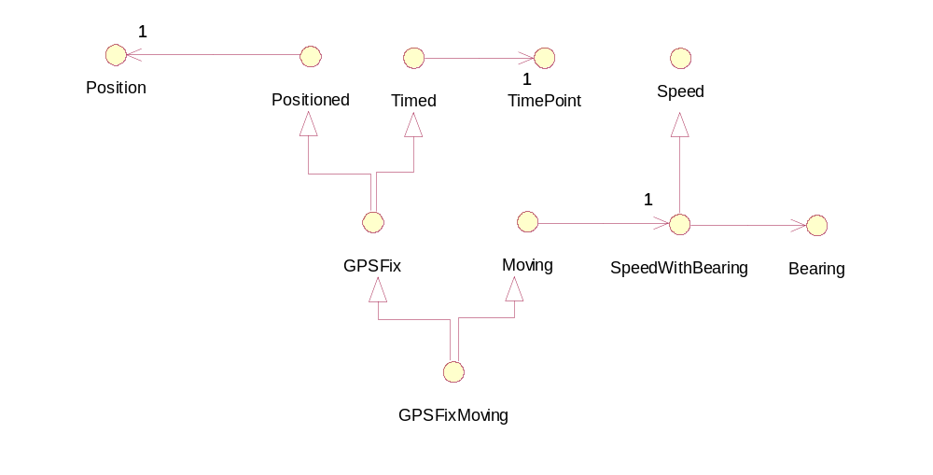
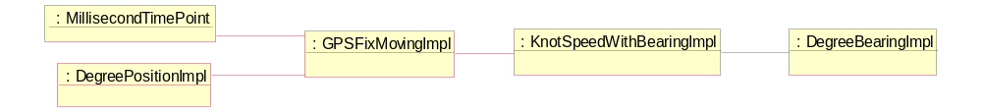
Further Performance Improvements by Saving Memory
Interfaces with naïve implementation classes → 5 objects for one GPS fix

Slide 32
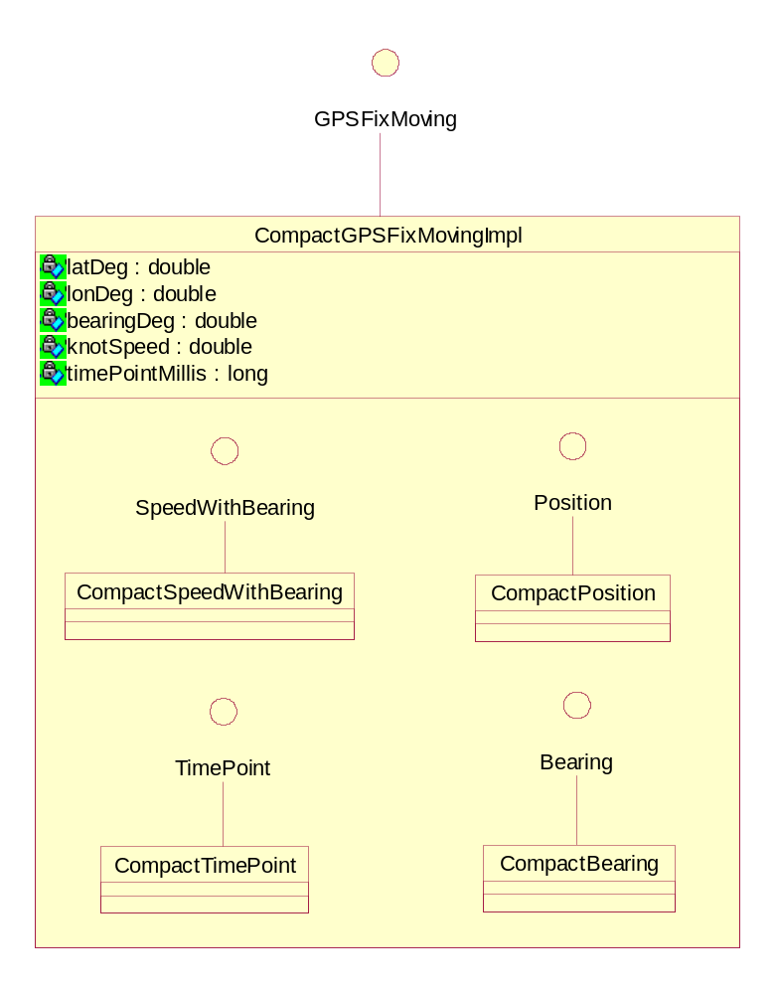
Use Compact Implementation, Saving Headers + Refs
Collect all fields of a containment hierarchy transitively
Store in one object
    Saves four object headers (4*16B=64B)
    Saves four object references (4*8B=32B)
    Payload: 5*8B=40B
    Single object header: 2*8B=16B
  Leaves 40% overhead instead of 280%
Objects of inner classes only needed temporarily
    Usually end up in Eden space
    Quickly GCed again
    Often don’t even leave stack frame
No change at all to interfaces and clients

Slide 33
Scaling an In-Memory Architecture with Replication

Slide 34

We Go to Extremes…
Since 2013 SAP is Proud Technology Sponsor of the Extreme Sailing Series
    See http://www.extremesailingseries.com
  Thousands of Followers World-Wide
  Hundreds at the VIP Area
  SAP is official score keeper for the 2013 series

Slide 35
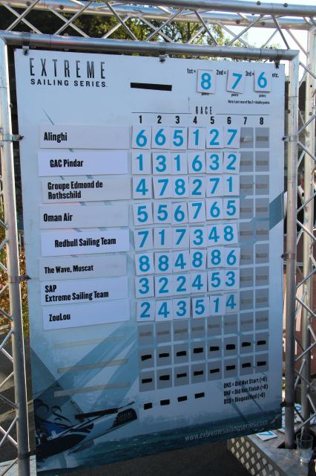
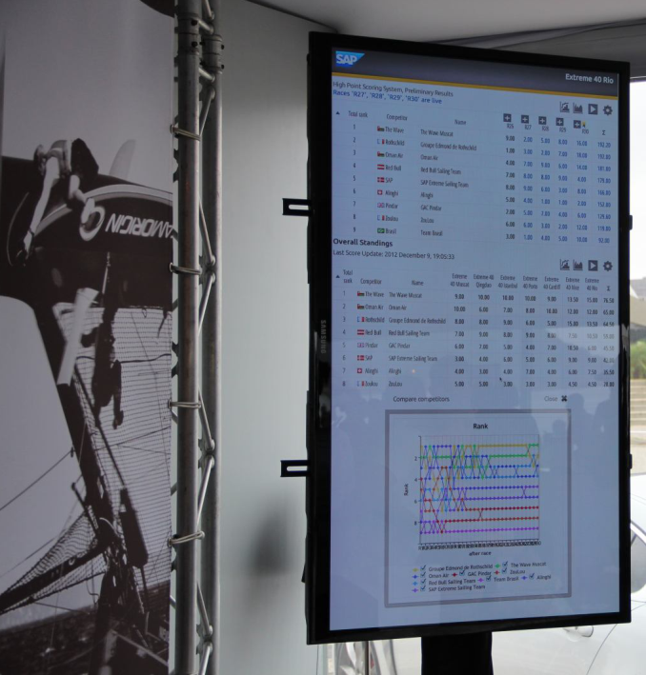
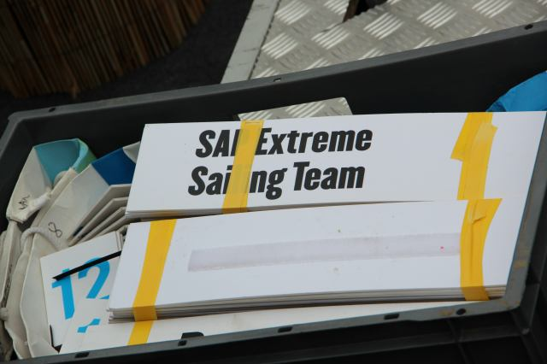
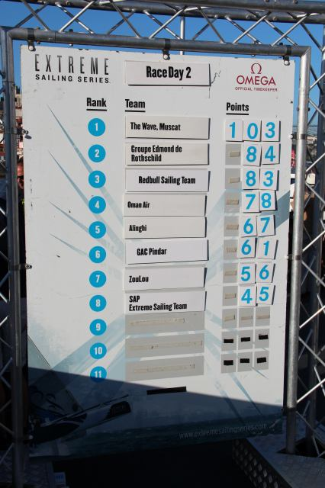
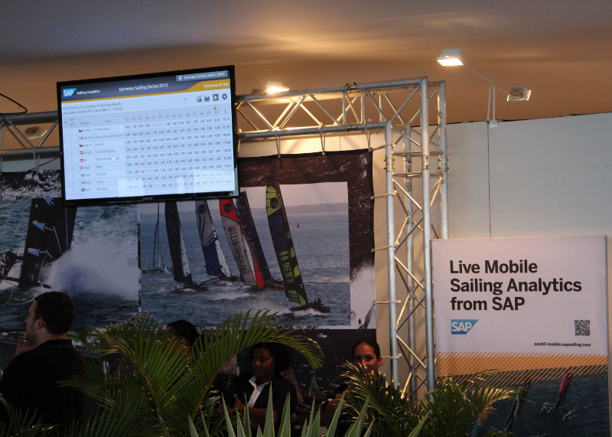
Live and Online Leaderboard Instead of Velcro

Slide 36
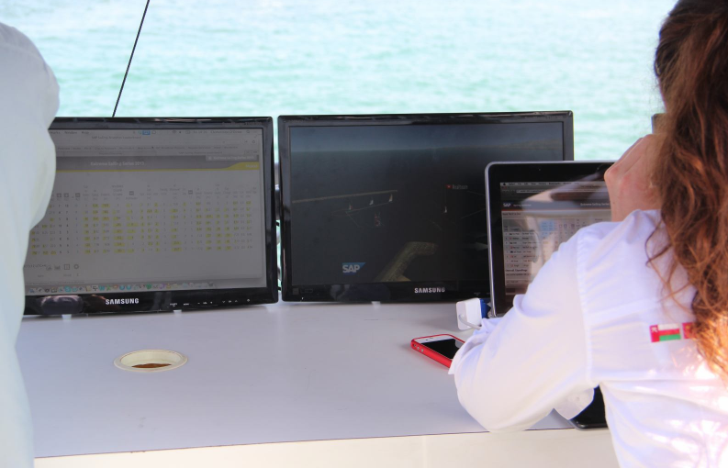
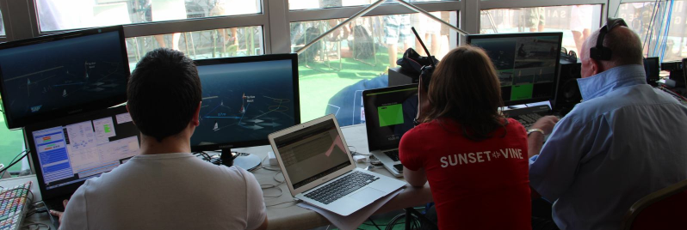
Sailing Analytics Used by Commentators and TV Team

Slide 37

Serving the Live Leaderboard for ESS Web Page
JSON RESTlets to feed the Live Act and Series Leaderboard

Slide 38
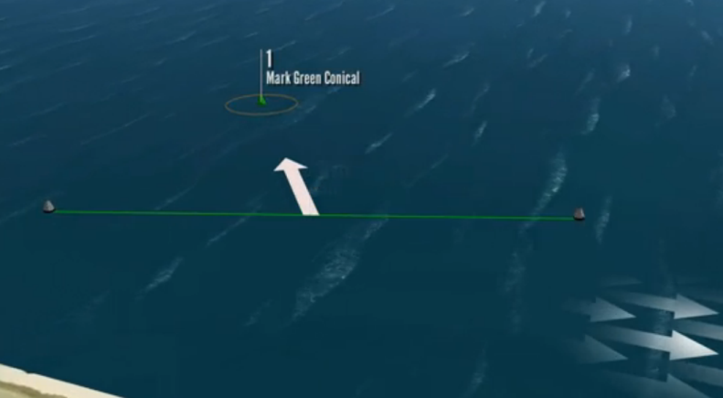
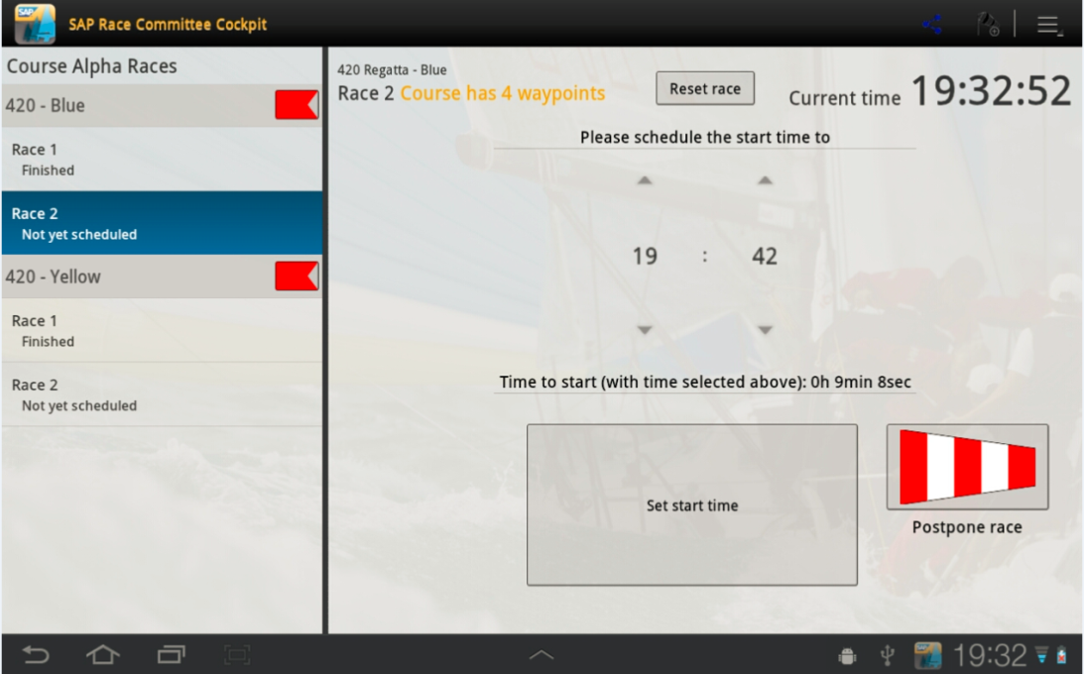
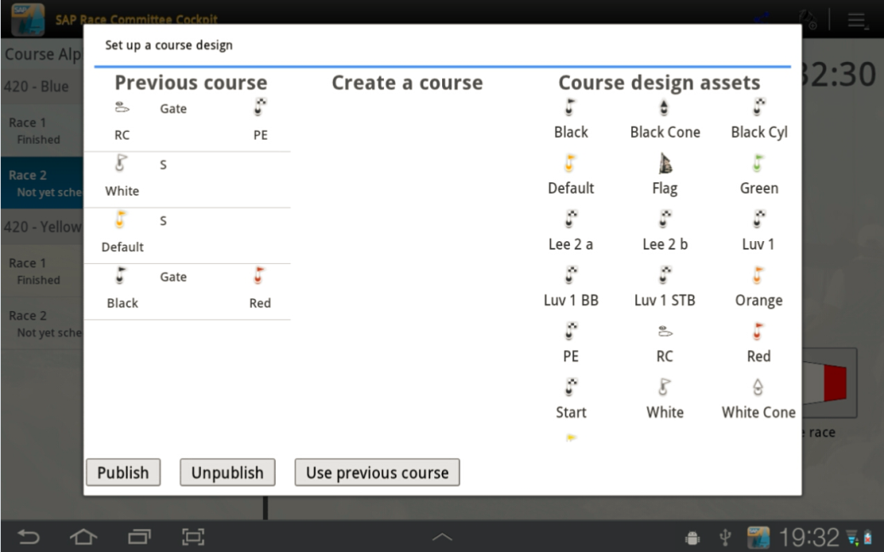
Android App for Race Committee Support
Announces Course and Race Start Time
Will be used for final result entry

Slide 39
How to Scale all This?
Scale-Up has its limits, scale-out inevitable over time.
Use Operation-based replication scheme
    All state changes to a master instance to be described by Operation objects
    Copy a master instance by serializing its state as an “initial load”
    Incrementally update replicas by pushing master operations through RabbitMQ
Potential to extend to a full-fledged Operation Transformation scheme
    Provides eventual consistency across master and replicas
    Allows operations to be originally applied to either master or replica
Additional benefits
  Wide-area distribution of replica supports on-site instance
    Low latency for commentators
    Can connect to a local server of a tracking provider
  Potential for quick fail-over with replicas choosing one of them as new master
    Need to address split-brain syndrome

Slide 40



Replication for Scale-Out and Fault Tolerance
sapsailing.com
Admin uses master
Expedition
replica
Toughbook
Initial load+
operations
UDP
sapsailing.com
UDP
Pound
Mobile hotspot
master
Initial load+
operations
TCP
sapsailing.com
replica
Data Center

Slide 41
Replication for Low-Latency On-Site Server
Expedition
DNS Server, Router
Toughbook
Fail-over
UDP
sapsailing.local
sapsailing.com
UDP
replicate
Mobile hotspot
master
replica
Fail-over
TCP
replicate
On-Site

Slide 42
Challenges with Replication
Initial Load
    Can take several minutes for a server with many races loaded at low bandwidth
Master Restart
    What about the replica’s state? How do they re-subscribe?
Disconnected Replica
    How to detect and how to react to temporarily or finally disconnected replica?
    How to clean up RabbitMQ queues for replica that “disappeared?”

Slide 43
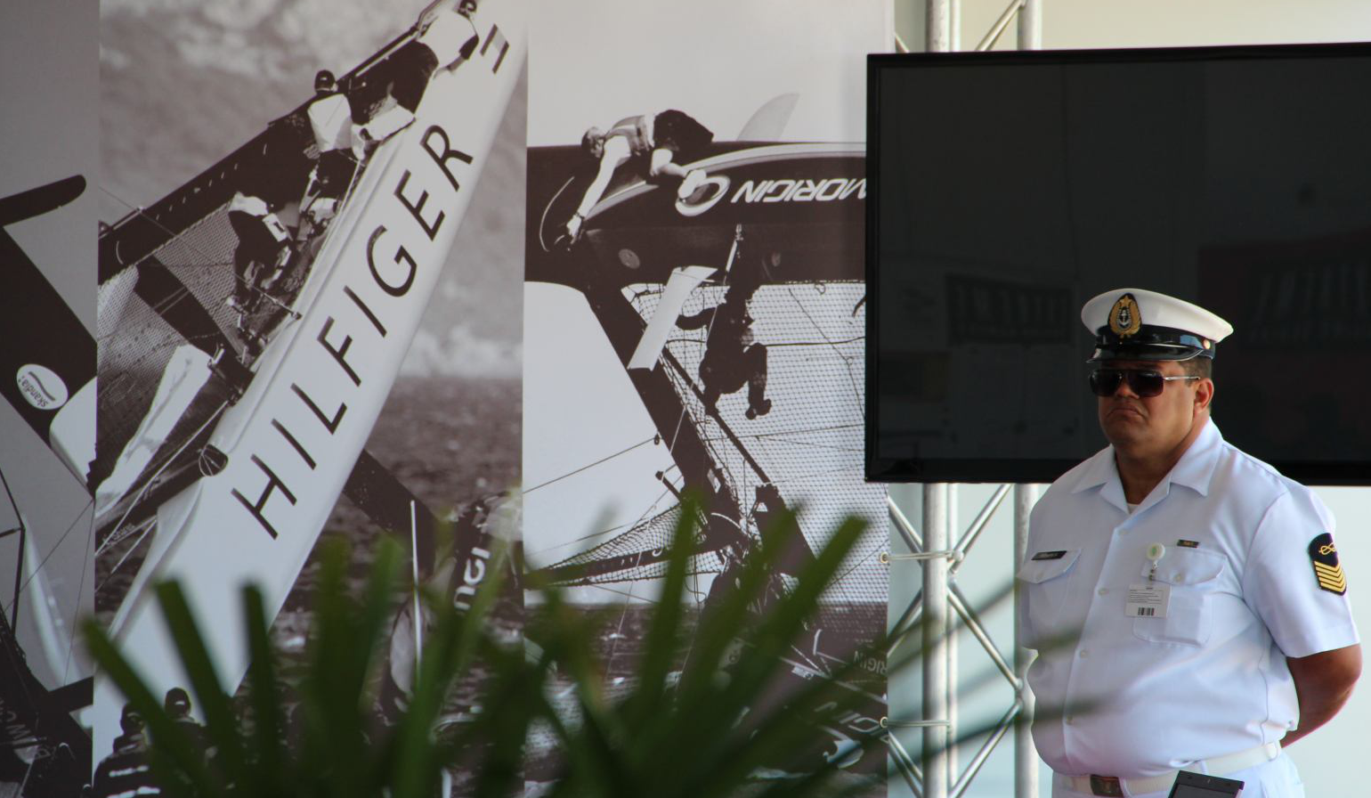
Are we Happy?

Slide 44
Summary and Outlook
From a Q&D prototype to an application with a bunch of fans and 150kLOC
Some architectural decisions survived and are considered helpful
    Use of Java, OSGi, Web Bundles, GWT, Eclipse as powerful tool environment
    In-Memory with DB as recovery-only works very well for live scenarios
    Java provides some basic means for parallelization and locking
Things that may need re-consideration
    Having to load all historic data to main memory seems questionable (though still feasible)
    Replication architecture by far not completed; tests at ESS look promising
    Equinox + Jetty + Apache combo showing some strange instabilities after a few weeks of up-time (Web Bundles end up in stale state and require bundle restart)
The Things to Come
    Users are increasingly asking for standard analytics features
    We will need to find good ways to hook up, e.g., to a Business Objects Universe
    Continue with massive creation of UI tests with Selenium
    Smartphone Tracking to reach out to smaller sailing clubs

Slide 45
More Background
http://www.youtube.com/watch?v=PDYLMWiB0Uw
http://www.youtube.com/watch?v=e4pUfNkrOa8
http://www.youtube.com/watch?v=w2hclkxZEoY
http://www.youtube.com/watch?v=8S2FOSWs_U0
http://www.youtube.com/watch?v=BjvSUpv6A4A
https://wiki.wdf.sap.corp/wiki/display/NWI/SAP+Sailing+Program

Slide 46
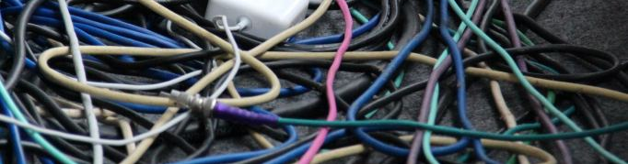
Questions?

Slide 47
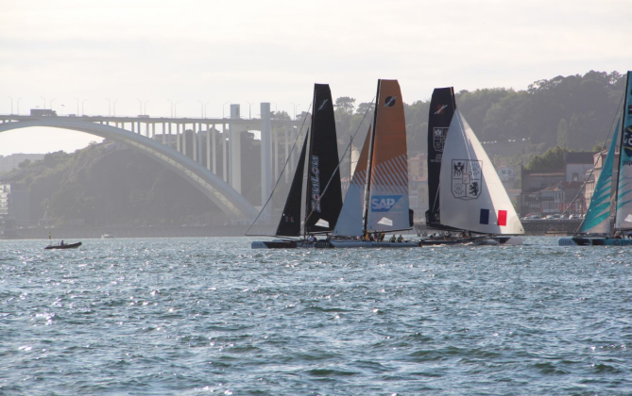

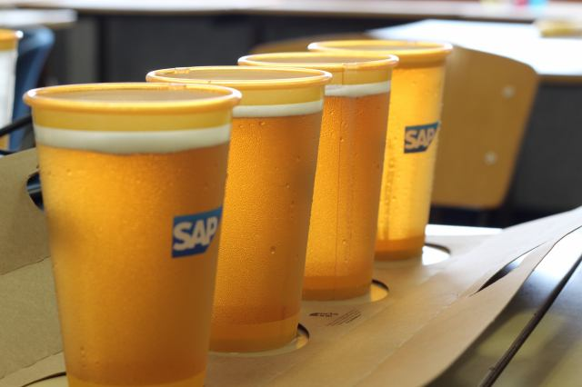
Thank you
Contact information:
axel.uhl@sap.com

