Slide 1
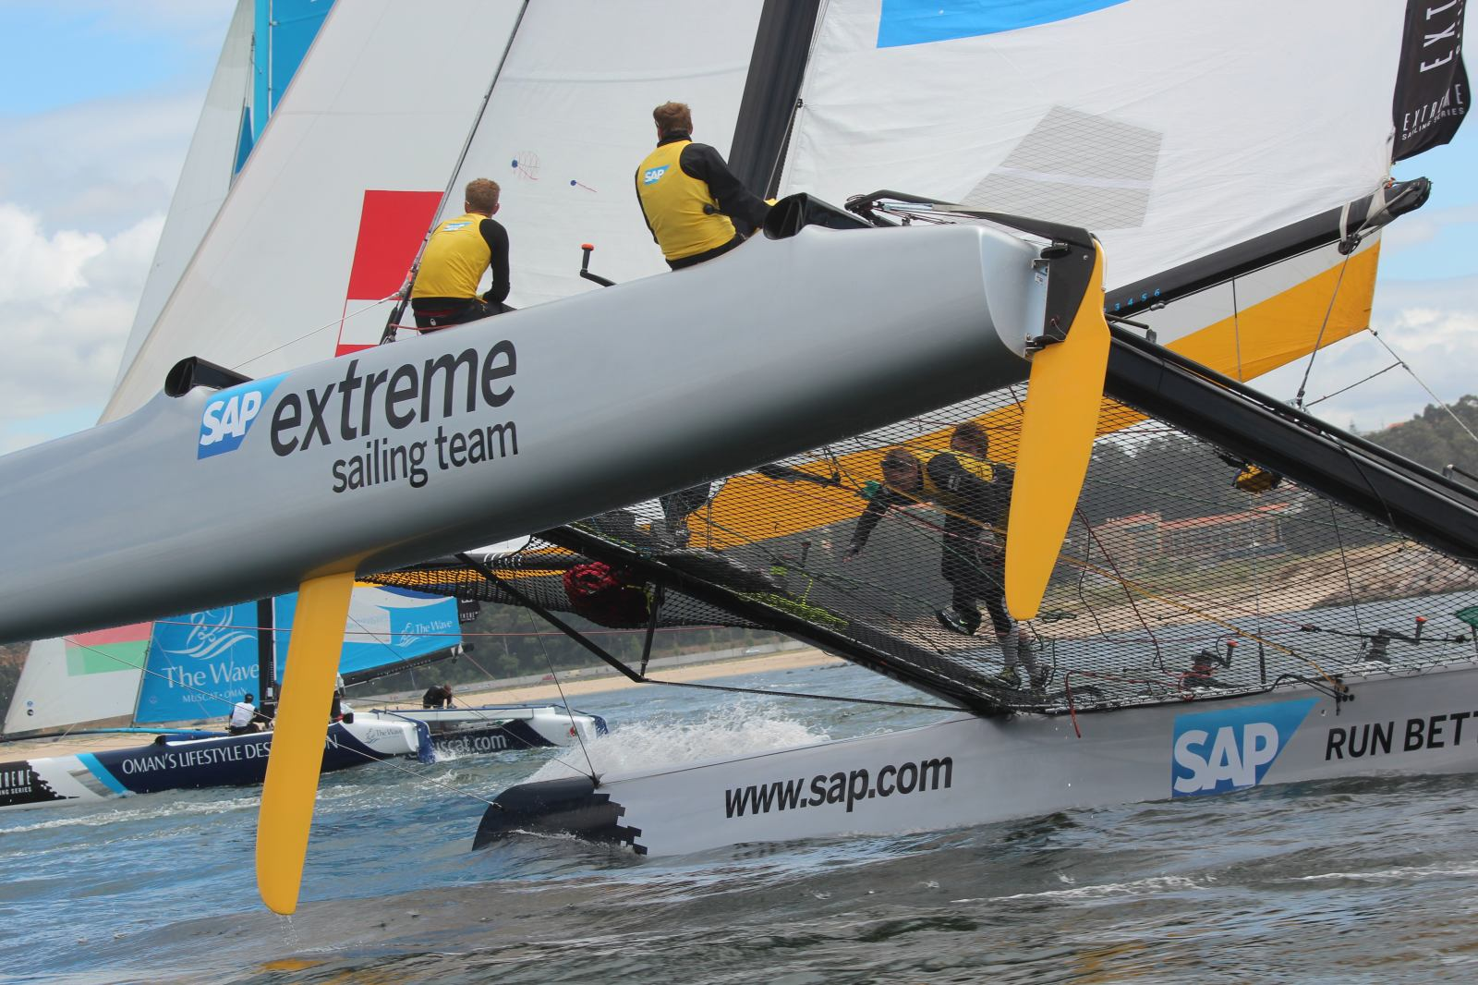

SAP Sailing Analytics
Software Architecture in a Showcase Set-Up
Axel Uhl, Global Sponsorships
March 21, 2013

Slide 2
Agenda
What is SAP Global Sponsorships About?
  History of Sailing in SAP Global Sponsorships
  From Kieler Woche 2011 to the 5O5 Worlds 2013 in Barbados
Laying the Cornerstones
  Java and OSGi, Git, Maven, MongoDB
  Recording and Analyzing Real-World Data in Memory with Java
Replacing a UI Layer
  From a Python-based Web UI to GWT
  Using OSGi Web Bundles
Caching and Locking in a Highly Concurrent Environment
Scaling an In-Memory Architecture with Replication

Slide 3

What is SAP Global Sponsorships About?

Slide 4


Slide 5
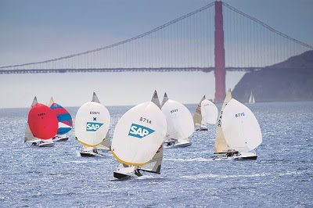

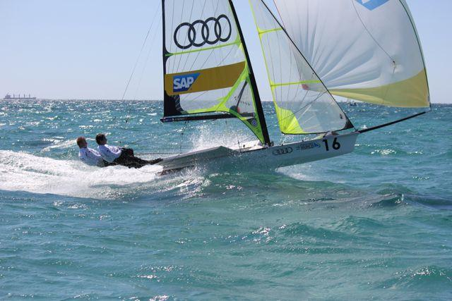
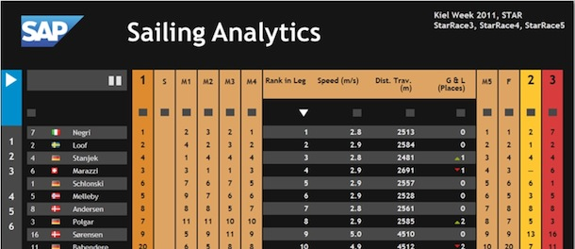
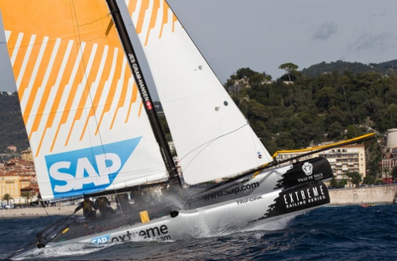
History of Sailing in Global Sponsorships
  SAP Sponsors the 5o5 Worlds Since 2009
    Hospitality Program
    Since 2010 Tracking-Based Analytics
  Kieler Woche 2011-2012
    First Live Leader Board with Basic Live Analytics (e.g., Speeds, Distances, Wind)
  Various Smaller Events with Live Analytics
    IDM Travemünde, MdM Hamburg, Young Europeans Sailing Kiel, BMW Sailing Cup Wannsee, Berlin Match Race, Dragon IDM Wannsee, 49er Euros Lake Garda
  Extreme Sailing Series
    Live Analytics for the last three acts of 2012
    Official Score Keeper and Analytics Provider for the 2013 Series
  See http://sapsailing.com

Slide 6

Gathering Live Data from Sailing Boats

Slide 7
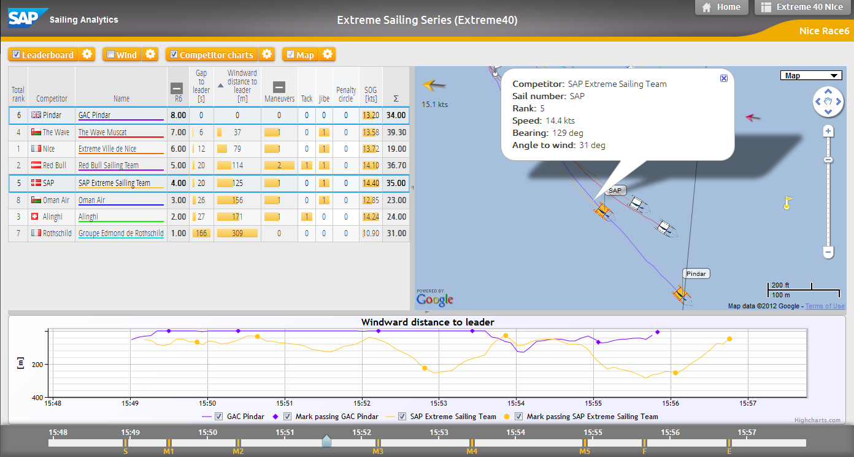
Analyzing a Single Race While It’s Live

Slide 8
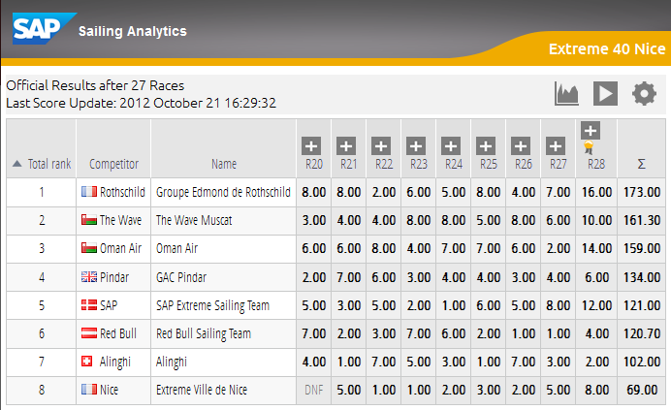
Live Regatta Leaderboard Based on Live Tracking

Slide 9
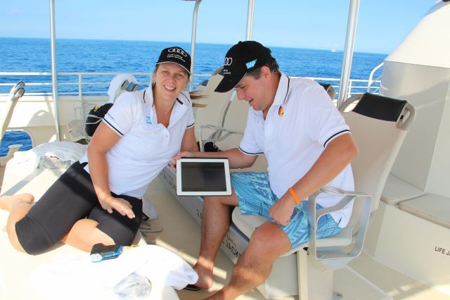
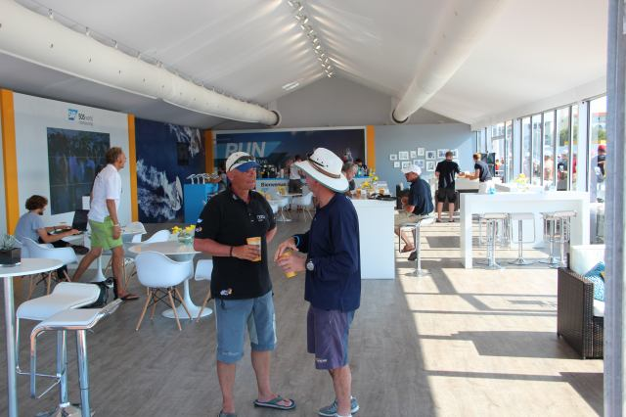
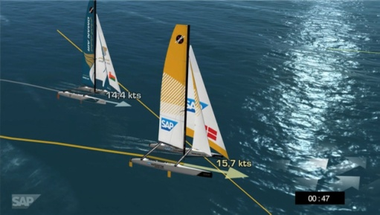
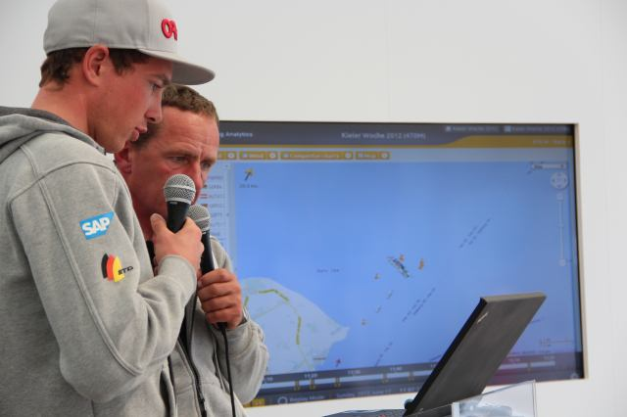
History of Sailing in Global Sponsorships
Typical Event Set-Up
  Hospitality Program with Spectator Boats
    Live Race Analytics shown to spectators on tablets
  Lounge
    iPads and big screens
  On-Shore Viewers
    Online live program with scheduled racing times and course areas
    Live 2D / 3D Course and Race Visualization on shore
    Live Internet streaming with commentary
    Sailors Debrief using the SAP Sailing Analytics

Slide 10

Laying the Cornerstones

Slide 11


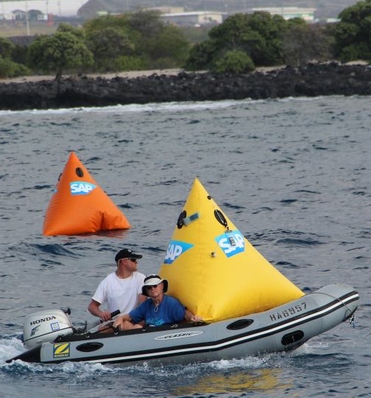
Started with Kieler Woche 2011 Requirements
Handle Live GPS and Wind Data
    Calculate Live In-Race Ranking Based on Wind and Boat Positions
    Provide Live Statistics about Distances, Speeds, Rank Changes, ETA
Choices for a Quick Prototype
  Java with OSGi/Equinox to record and analyze live data
    Insert-only; queries aggregate on the fly
    Parallel aggregations for different key figures per query
    Coarse-grained used of synchronized as q&d “locking”
    Rendered JSON for multi-race leader-board in <10ms
  Embedded Jetty as Servlet/RESTlet container
    Explicit registration of RESTlets in bundle activator
  Python to render HTML front-end
  REST/JSON interfaces between Python and Java
  Git, Junit, Maven, Hudson, MongoDB

Slide 12



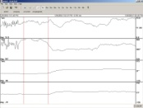




Kieler Woche 2011 System Landscape, Data Flow
sapsailing.com
HTTP
Expedition
Toughbook
TCP
UDP
TCP
UDP
Mobile hotspot
GSM / GPS Boat Tracker

Slide 13
Inside sapsailing.com
sapsailing.com
Apache
Java Equinox
Python
MongoDB
Wind and config data

Slide 14
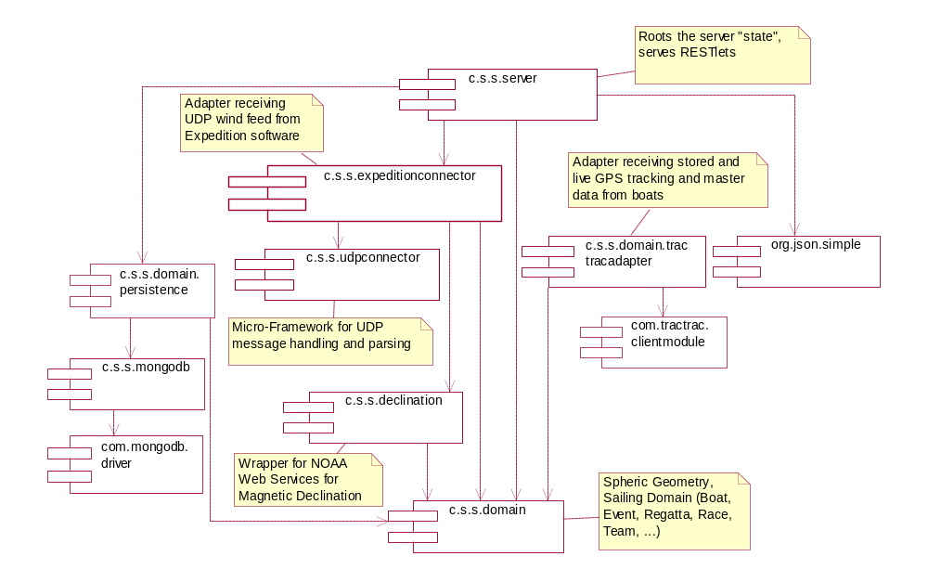
Early Bundles Living Inside the Java Server

Slide 15
Produced this Output after Four Weeks

Slide 16
Evaluation of First Prototype
UI layer
    Python server instance somehow redundant → move to GWT, eliminate Python instance
In-Memory On-the-Fly Aggregation
    Works nicely, particularly for out-of-order delivery of GPS and wind data
    Parallel execution results in nice speed-up for large leader-boards
    Use of synchronized as poor-man’s locking replacement doesn’t scale particularly because of read-read lock-out → move to ReentrantReadWriteLock
    First few key figures were well-chosen → add more, exciting figures for sailors
    Front-end used only by one or two users so far → scaling to many users so far not required
Use of DB mostly for Recovery Only
    Works well for the data volumes we face so far. All tracking of Kieler Woche takes less than 1GB of Java heap space.

Slide 17
Replacing a UI Layer
  From a Python-based Web UI to GWT

Slide 18
Google Web Toolkit (GWT)
Allows Java developers to build rich, dynamic HTML5 applications
    Cross-compiles Java to efficient JavaScript
    Uses the Eclipse Java debugging infrastructure
    Can be made play reasonably well with OSGi
    Code can be shared between server and browser if a few constraints are obeyed
    Powerful Eclipse JDT features available also for browser code
New versions of the leader-board and administration console
    Replaces Python server instance
    Runs more efficiently because more can be done in the browser more easily

Slide 19
Leaderboard as Re-Built with GWT

Slide 20
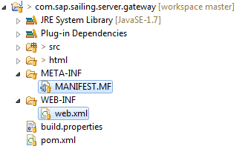

Switched from Explicit Registration to OSGi Web Bundles
Turned all Servlet/RESTlet providers into OSGi Web Bundles
    No longer requires explicit registration in activator
    Bundle start/stop and registration / deregistration handled automatically
    Easily supports exposing web content
Easy compatible upgrades of UI and gateway bundles in running server
    Helpful if server state is a bit expensive to re-construct after start-up
In MANIFEST.MF

Slide 21
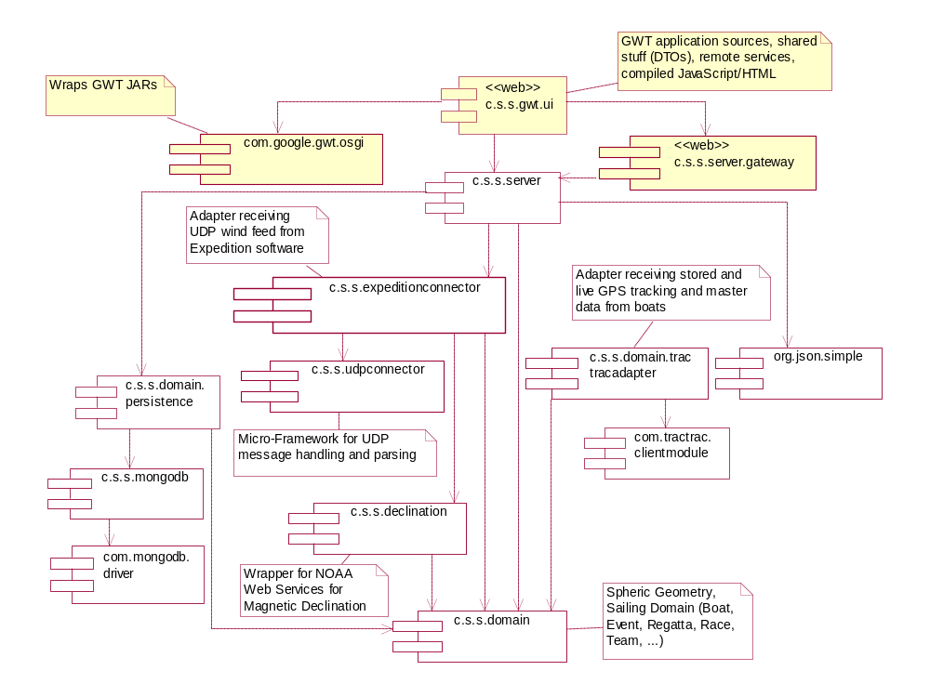
GWT Bundles in OSGi

Slide 22

Caching and Locking in a Highly Concurrent Environment

Slide 23
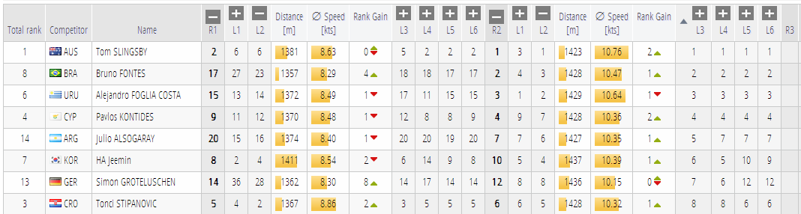
Core Computations Easily Run in Parallel
  The calculations populating each red box are executed in one task.
  Each task is assigned to an Executor and can run concurrently.
  However, sensor feeds compete with reading tasks for data structure locks.

Slide 24
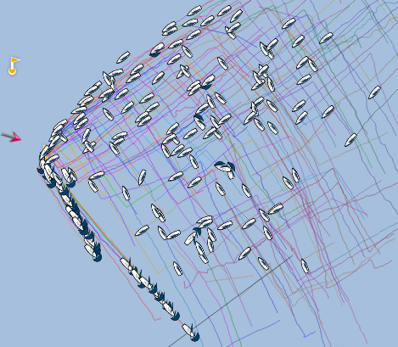
Growing Complexity, Growing Data, More Users
5o5 Worlds 2012, La Rochelle, France
    ~190 boats in one fleet, racing concurrently for two hours/race
    In addition to commentary, several users in VIP lounge and on
    tablet devices
Where “insert-only” and “aggregate on the fly” bit us
  Simple example: distance traveled for one competitor
    Find first fix at or after start line passing
    Sum up great-circle distance to the next fix that’s not an outlier
  For a leader-board that’s O(c*f) with c=number of competitors and f=number of fixes
    And the price per operation is quite high as it involves trigonometric functions
  Leader-board re-calculation times went up to >2s per request towards the end of a race
  More users started accessing our stuff → many similar expensive requests

Slide 25
Consider Caching
Major Nightmare, Pandora’s Box
    For each cached result, need to remember when to invalidate cache.
    Calculation rule changes → invalidation logic needs to change accordingly
    Feels like re-building Excel…
    …but seems inevitable to us when calculations on raw data become more complex and number of concurrent users goes up.
Cache Invalidation with Out-of-Order Delivery
  Tricky as one needs to know the cached scope affected by a single fix.
  Example:
    Wind is calculated as weighted average 15s before and after the requested time point.
    A new wind fix will affect the average for 15s before and after its time point.

Slide 26
Best Effort Caching
All queries consider a time point with millisecond resolution.
  Makes cache hits pretty unlikely…
  …unless we manage to project some time points to a single time point
    Example: querying after last change of a race projects to end of the race
Consolidate all Live Access
    If a client asks for “live” data, it gets what the server has, no matter the “client time”
New facts that need to invalidate a best-effort cache trigger re-calculation
    Clients continue to receive outdated results until re-calculation has finished.
    This way, clients don’t block for the sometimes expensive cache updates.

Slide 27
Locking
ReentrantReadWriteLock Learnings
  Works much better than synchronized because of concurrent reads
  Use fair locks where needed
  Example: course updates
    Compete with almost all reading operations
    If non-fair lock were used, course update would have to wait forever
  Fair locks can lead to a read-read deadlock
    Thread T1 owns B.read and requests A.write (doesn’t get it because T3 owns A.read)
    Thread T2 requests B.write (doesn’t get it because T1 owns B.read)
    Thread T3 owns A.read and requests B.read (doesn’t get it because B.write came earlier)
    Looking only at T1 and T3, it seems there is a deadlock between two readers of B!
Tracing Support Required
    Eclipse deadlock detection doesn’t catch read-write conflicts as they are two Lock objects
    We trace logs held long with their reader and writer stack traces

Slide 28
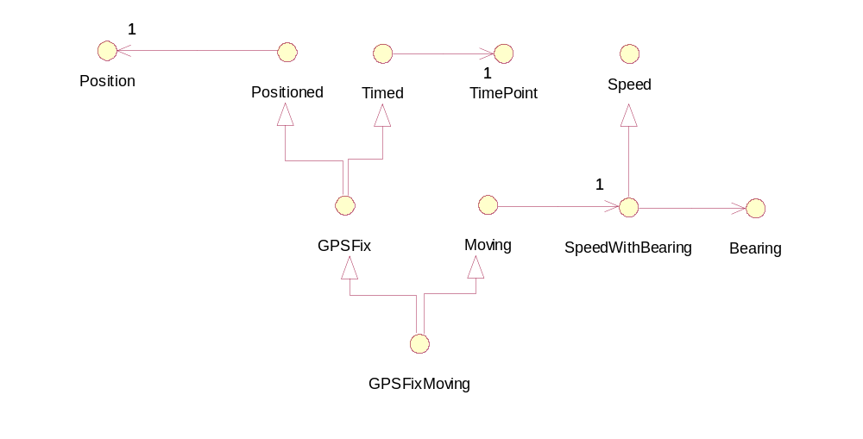
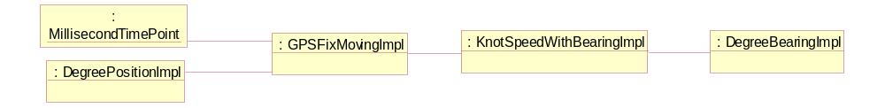
Further Performance Improvements by Saving Memory
Interfaces with naïve implementation classes → 5 objects for one GPS fix

Slide 29
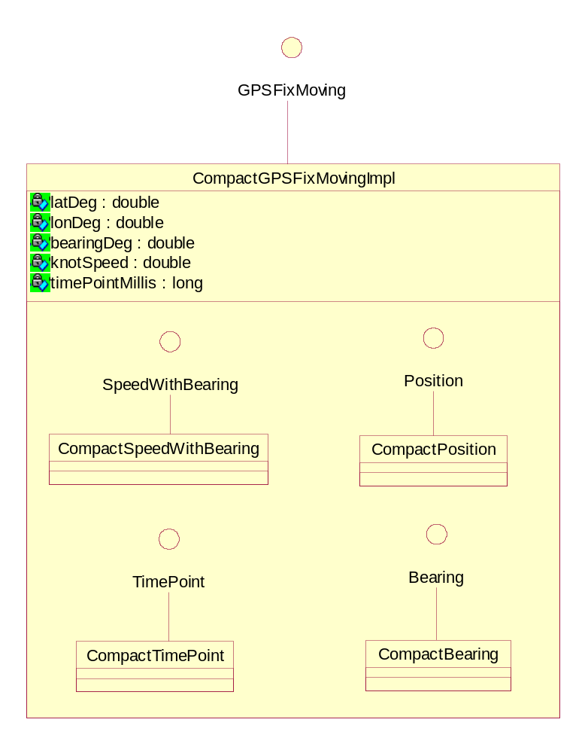
Use Compact Implementation, Saving Headers + Refs
Collect all fields transitively
Store in one object
    Saves four object headers (4*16B=64B)
    Saves four object references (4*8B=32B)
    Payload: 5*8B=40B
    Single object header: 2*8B=16B
  Leaves 40% overhead instead of 280%
Objects of inner classes only needed temporarily
    Usually end up in Eden space
    Quickly GCed again
    Often don’t even leave stack frame

Slide 30
Scaling an In-Memory Architecture with Replication

Slide 31
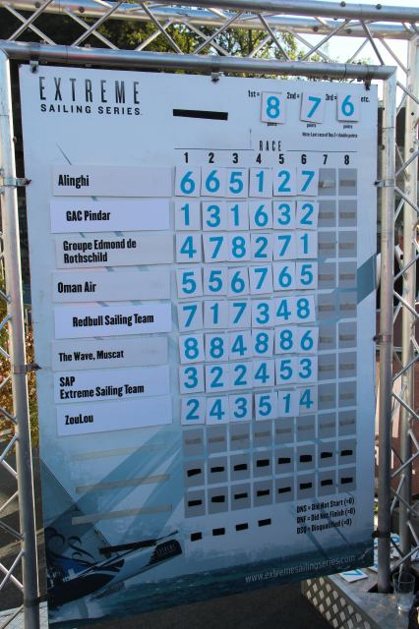
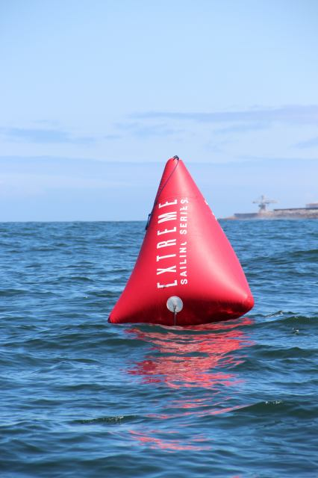
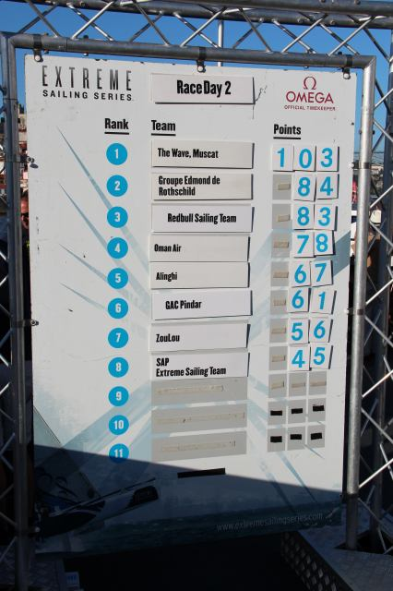
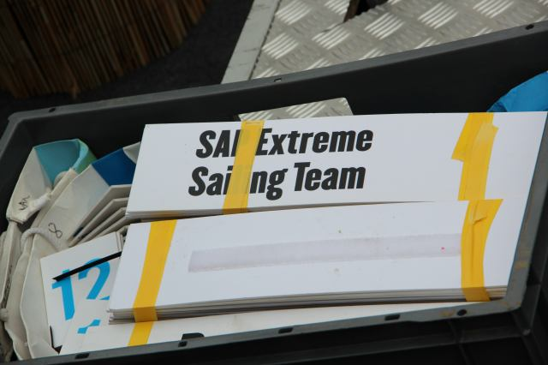
Insert page title
First level
  Java and OSGi, Git, Maven, MongoDB
  Recording and Analyzing Real-World Data in Memory with Java
  Second level
    Third level

Slide 32
Insert page title
First level
  Java and OSGi, Git, Maven, MongoDB
  Recording and Analyzing Real-World Data in Memory with Java
  Second level
    Third level

Slide 33
Insert page title
Subtitle
First level
  Second level
    Third level

Slide 34
Open Issues, Outlook

Slide 35
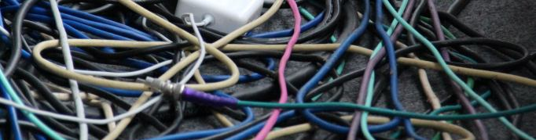
Questions?

Slide 36
Insert page title
First level
  Second level
    Third level

Slide 37
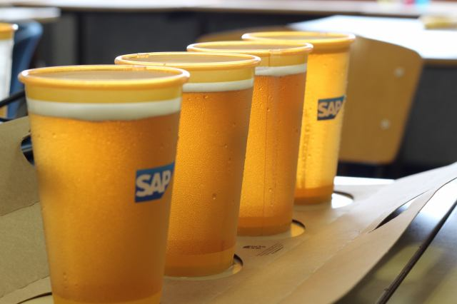

Thank you
Contact information:
axel.uhl@sap.com

